Slide 1

WQF7023 Artificial Intelligence Research Project 2
2025/2026 Semester 1
Explainable Demand Forecasting for Retailers using Graph Neural Networks and Temporal Fusion Transformers
Supervisor: ASSOCIATE PROF.TS.DR.Aznul Qalid Bin MD Sabri
Student: 23115588 Maksatbek kyzy Aizhan

Slide 2
Introduction
Research Questions and Research Objectives
Temporal Fusion Transformer
Spatio-Temporal Graph Neural Network
Hybrid GNN-TFT
Summary
Content of the Presentation

Slide 3

Introduction
Demand forecasting is central to retail success, enabling efficient inventory and resource management.
Complex supply chains and logistics increase the need for advanced, AI-driven forecasting models.
This research explores GNN, TFT, hybrid GNN-TFT models, prioritizing both predictive accuracy and model explainability.
Explainable AI builds trust and transparency, ensuring retail stakeholders can understand and act on model insights.

Slide 4

Research Questions and Objectives
1
2
3
Which approach yields higher accuracy in retail demand forecasting: GNN, TFT, or a hybrid GNN-TFT model?
To evaluate and compare the forecasting accuracy of GNN, TFT, and hybrid GNN-TFT models.
Which features within the retail dataset have the greatest and least impact on the predictive accuracy of these models?
To interpret model predictions by applying both model-specific and model-agnostic explainable AI (XAI) methods.
What architectural improvements are most effective for optimizing the performances of models?
To find and implement architectural improvements, aiming to maximize predictive performance and operational value of models.

Slide 5
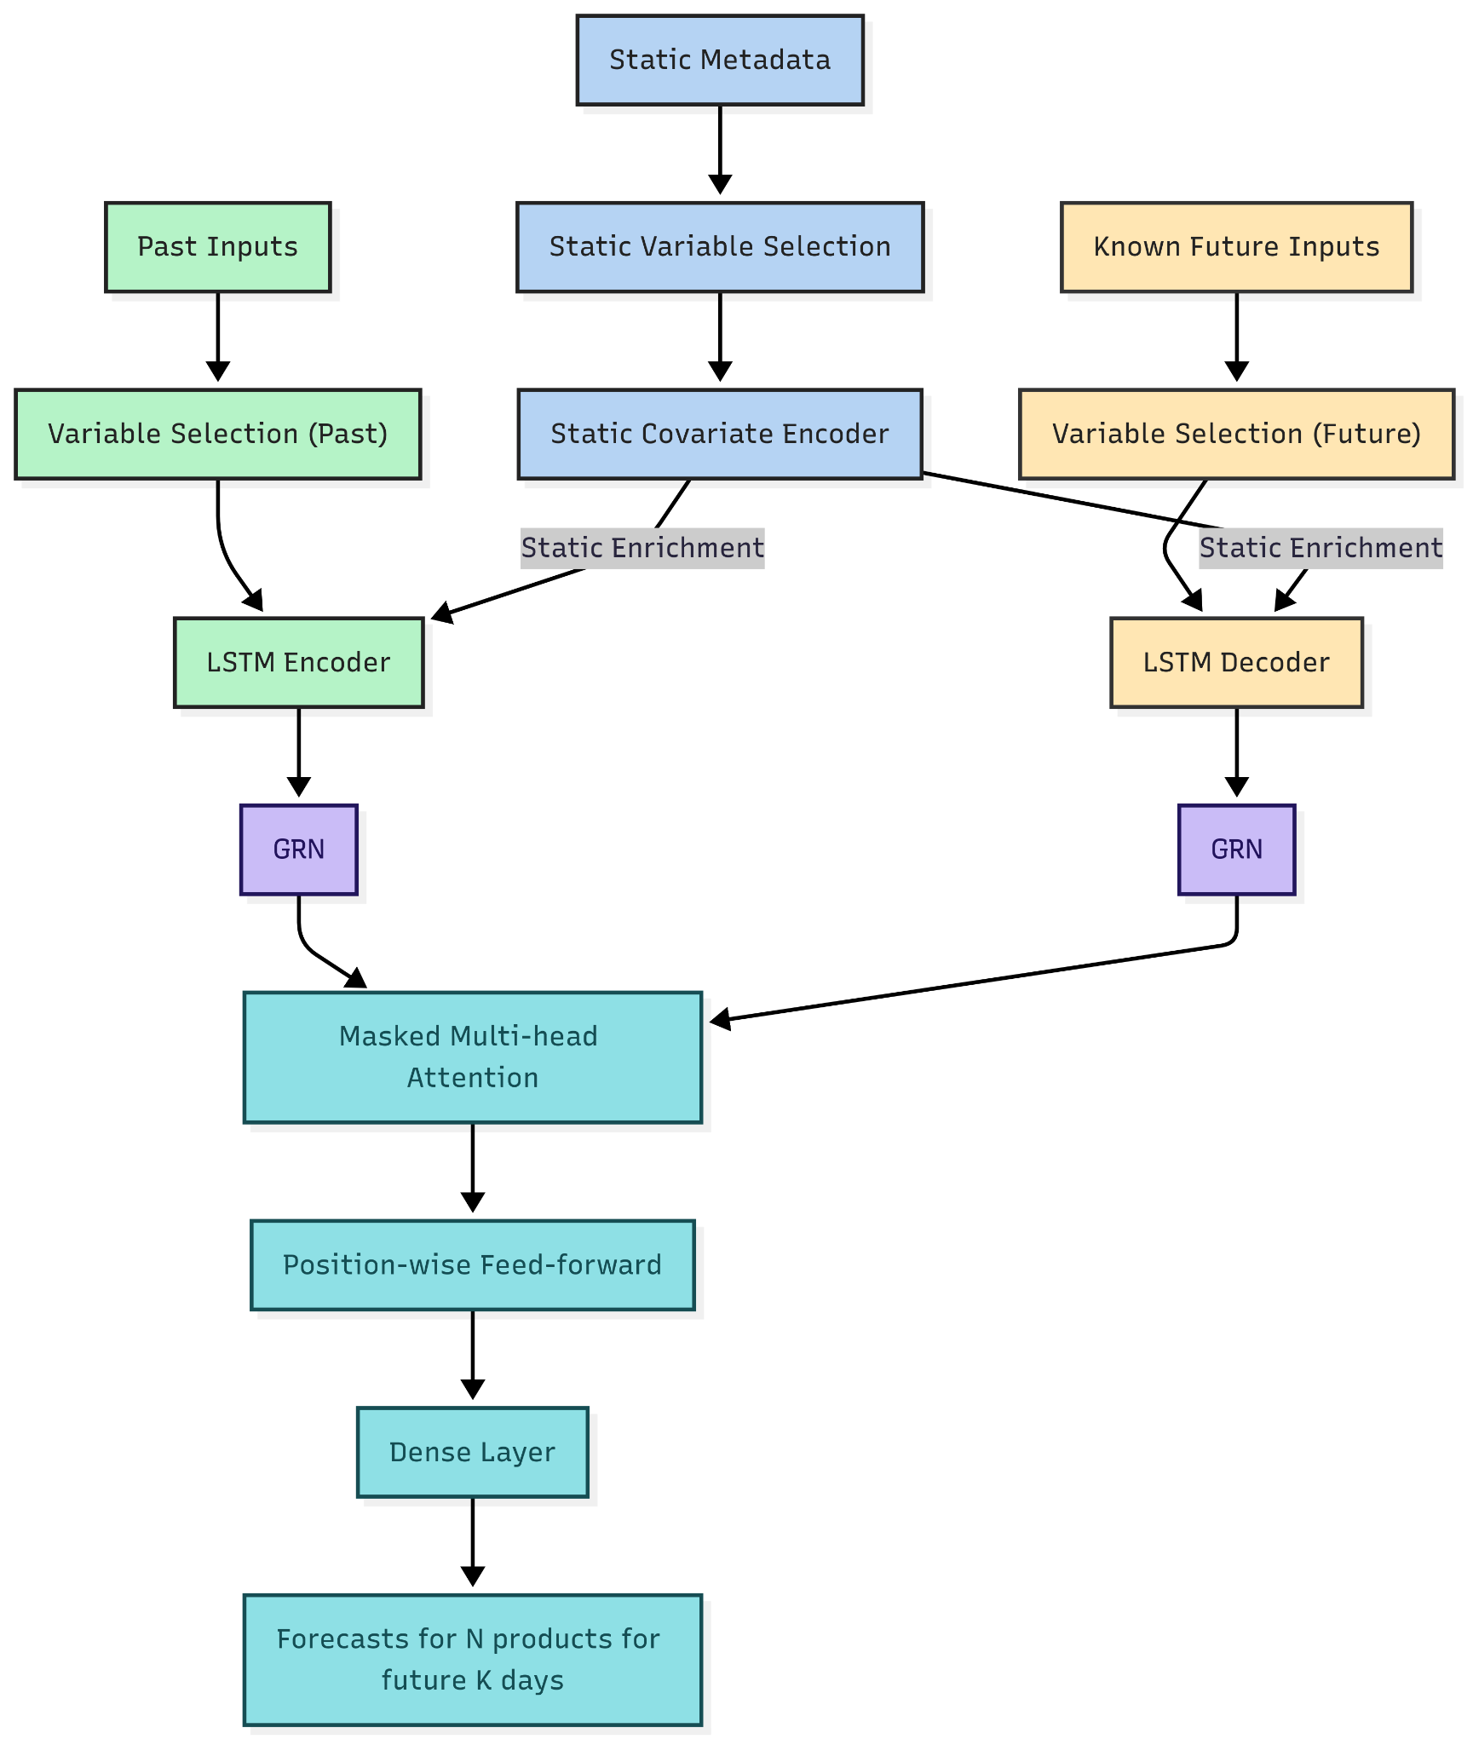
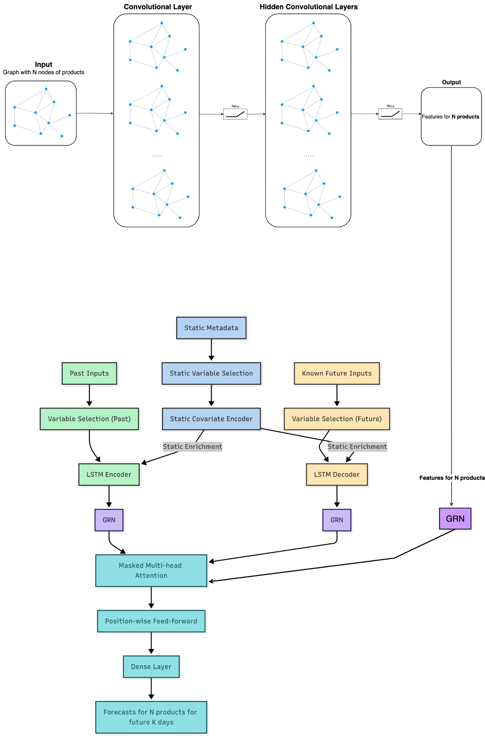
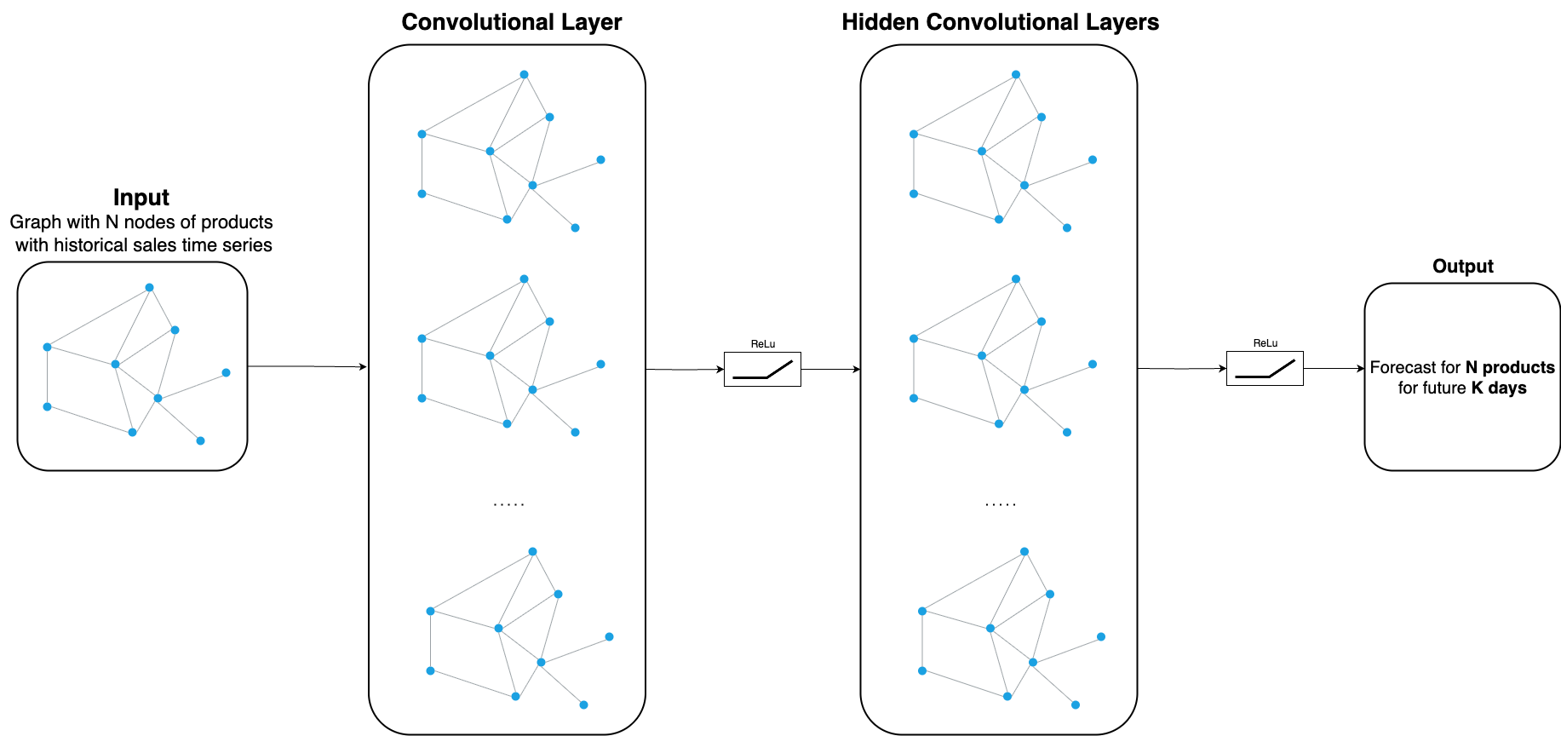
Model Architectures
TFT
Hybrid GNN-TFT
GNN

Slide 6
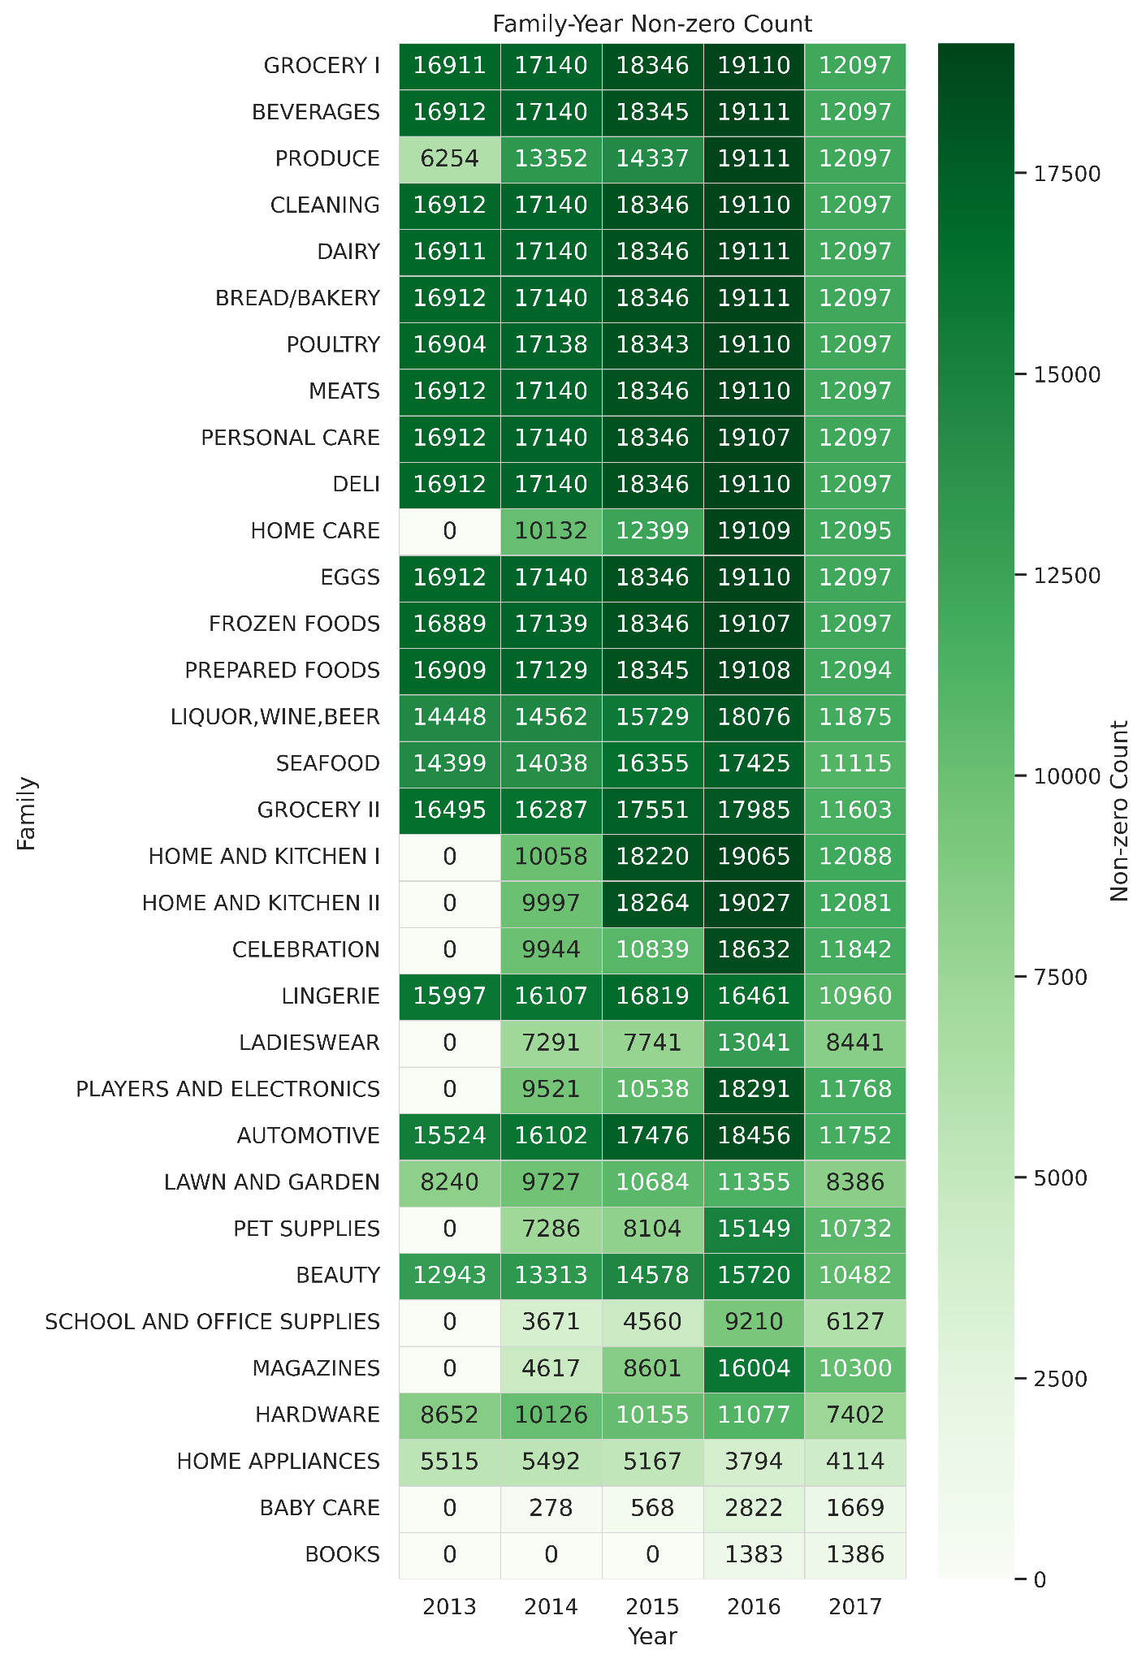
33 - product families
54 - stores
5 - store types
17 - store clusters
22 - states
Data - Favorita Grocery
grocery and household have high daily non-zero sales from 2013 to 2016, with a peak in 2016 and a drop in 2017
home care, baby care and books either started later or have much sparser sales

Slide 7
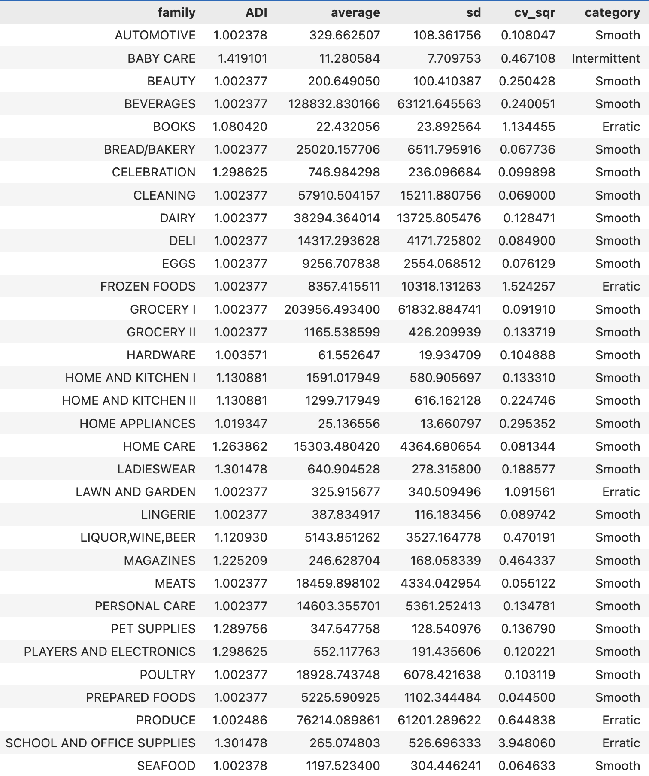
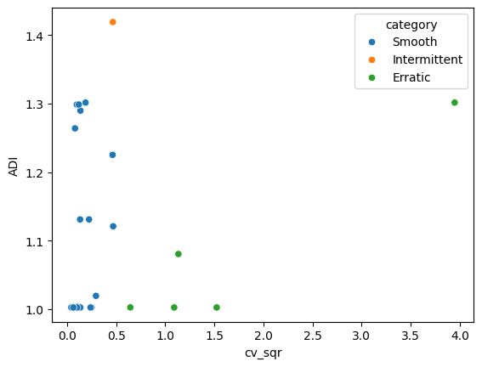
Forecastability
Average demand interval
squared Coefficient of Variation
Type | Range | Description
Smooth | ADI < 1.32 CV² < 0.49 | Demand is regular both in timing and magnitude. Forecasts are relatively straightforward, with low expected error.
Intermittent | ADI ≥ 1.32 CV² < 0.49 | Quantities exhibit little variation, but the intervals between demands are irregular and often lengthy. While specialized methods address intermittency, forecast errors tend to be higher.
Erratic | ADI < 1.32 CV² ≥ 0.49 | Demand occurs at regular intervals, but quantities vary substantially. Forecast accuracy is unstable and difficult to maintain.
Lumpy | ADI ≥ 1.32 CV² ≥ 0.49 | High variability is present in both timing and quantity. Producing reliable forecasts is generally infeasible, regardless of the forecasting technique employed.

Slide 8
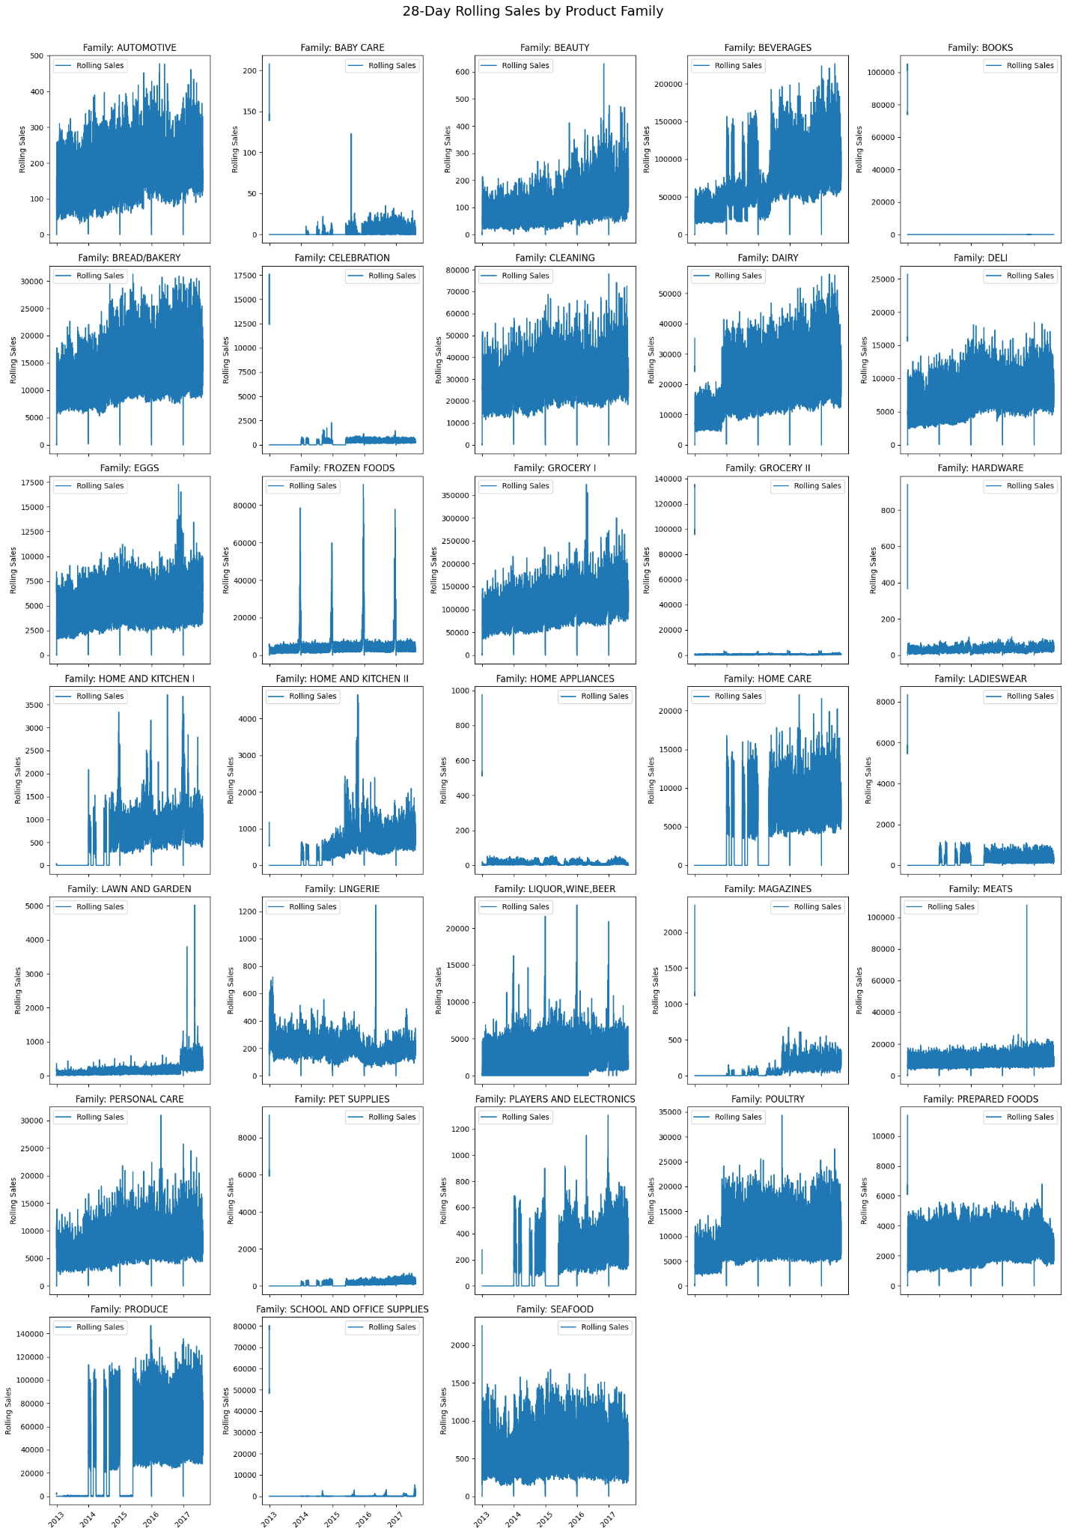
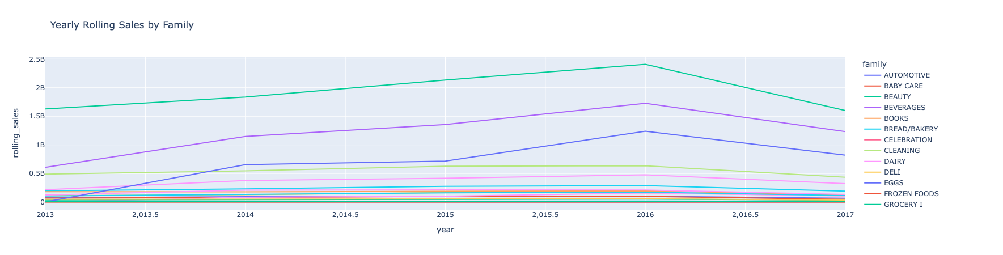
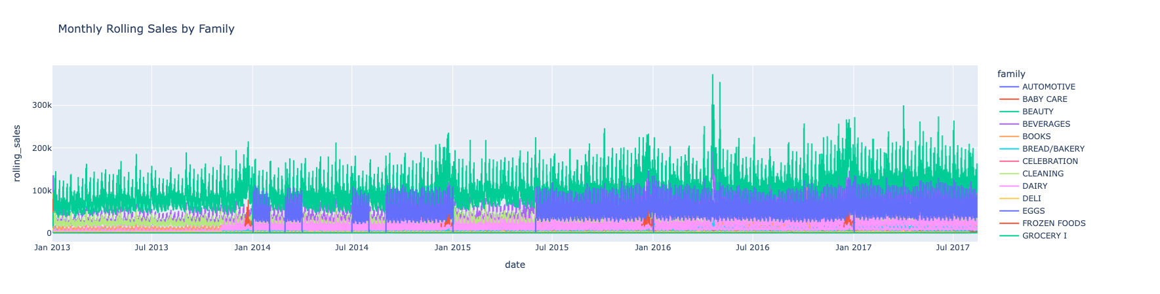
Amount of sales over a periodic duration window for the different product families

Slide 9
Prediction Model Scope: Category vs. Entire Sales
Developed at the product family (category) level (33 families), not individual SKUs.
Advantages:
Captures robust sales patterns and seasonality due to reduced volatility at the category level.
Yields more stable and accurate forecasts, especially when SKU-level data is sparse or highly variable.
Reduces computing cost significantly compared to building models for each SKU.
Rationale:
Effective as an initial step to understand broad sales trends and optimize resource allocation.
Once established, the approach can be extended to SKU-level forecasting for detailed inventory planning.
Note:
SKU-level forecasting is ultimately preferred by store managers, and can be implemented as data and modeling processes mature.

Slide 10

Results
Temporal Fusion Transformers
Spatio-Temporal Graph Neural Networks
Hybrid GNN-TFT

Slide 11
1
Temporal Fusion Transformer

Slide 12
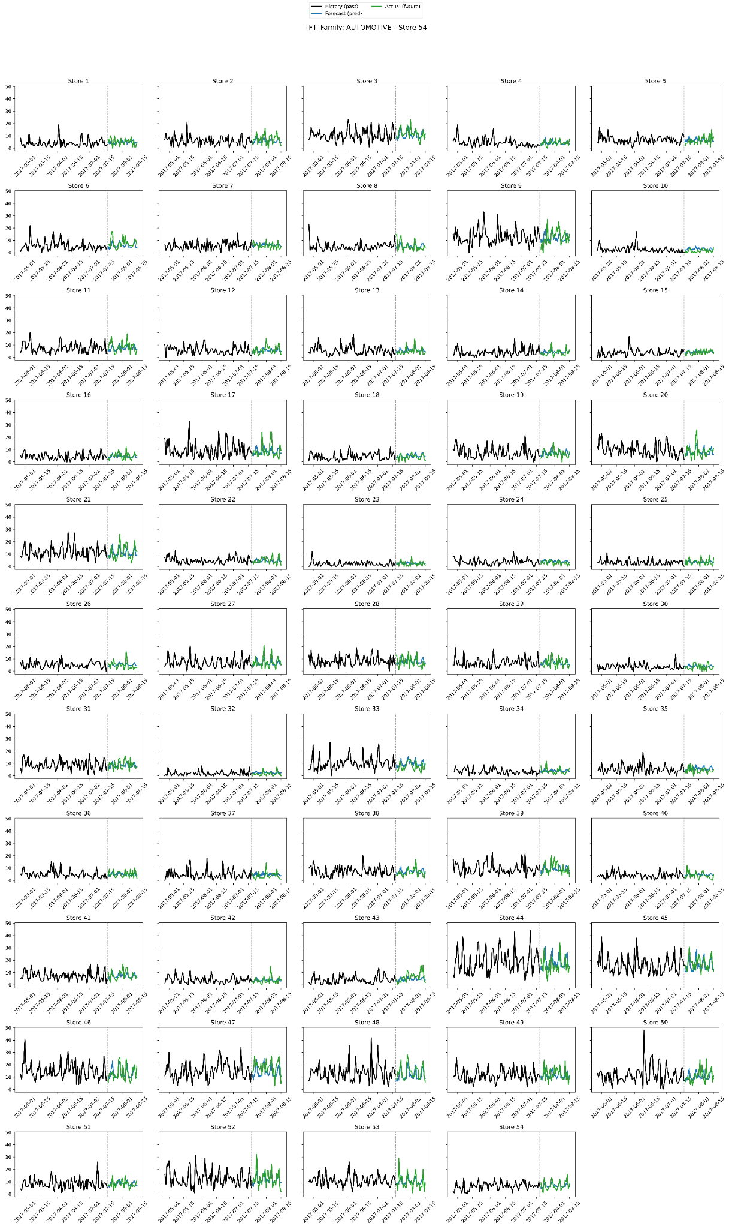
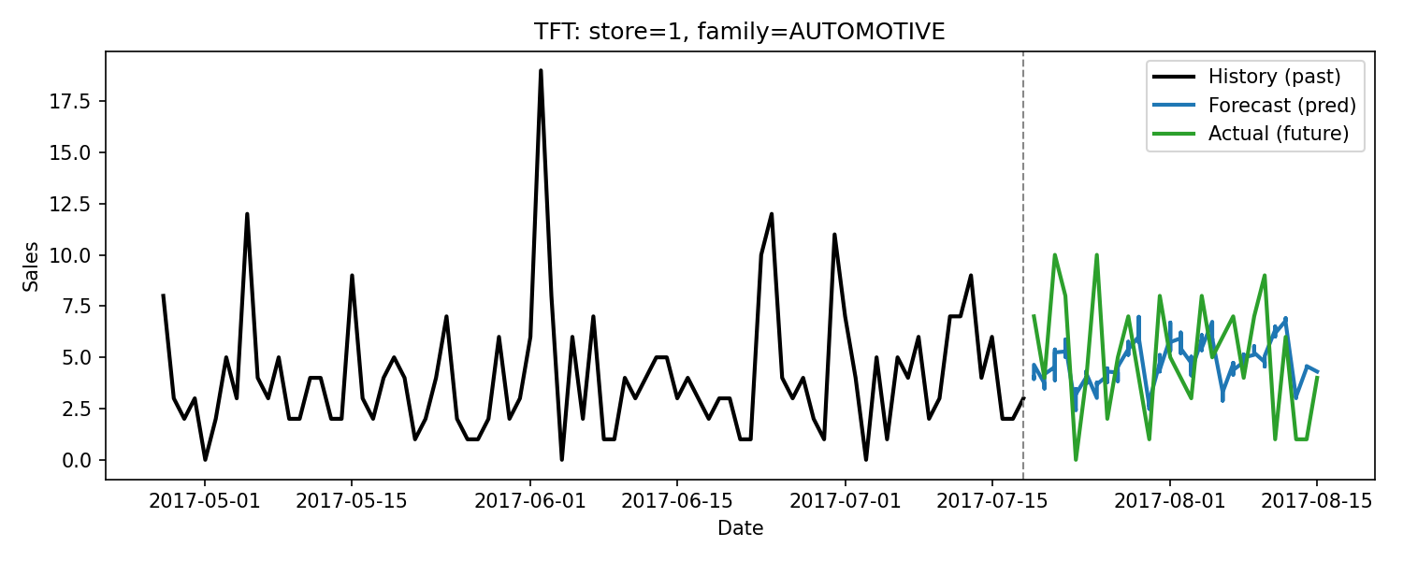
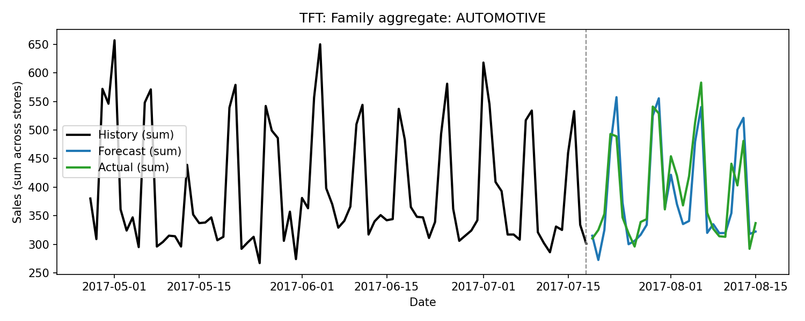
Temporal Fusion Transformer

Slide 13
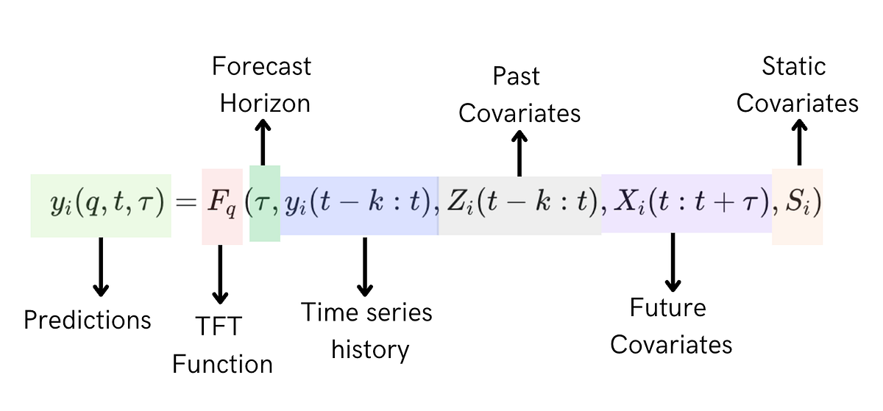
TFT Input Data
Image Reference: Medium
Feature Category | Feature Name
Past observed (9 total) | sales transactions daily oil price promotion day of the week month week of the year holiday workday
Known future (6 total) | promotion day of the week month week of the year holiday workday
Static (4 total) | store number product family store state store cluster

Slide 14

XAI

Slide 15
Model-Agnostic Method
Permutation Importance
Space | Variable | ΔWAPE
Decoder (future) | onpromotion | 0.1053
 | dow | 0.0216
 | month | 0.0130
 | weekofyear | 0.0107
 | is_holiday | 0.0024
 | is_workday | 0
Encoder (historical) | sales | 0.0280
 | transactions | 0.0020
 | onpromotion | 0.0018
 | is_holiday | 0.0002
 | dow | 0.0001
 | is_workday | 0
 | weekofyear | -0.0001
 | month | -0.0004
 | dcoilwtico | -0.0016
Static | state | ~0
 | cluster | ~0
 | family | ~0
 | store_nbr | ~0

Slide 16
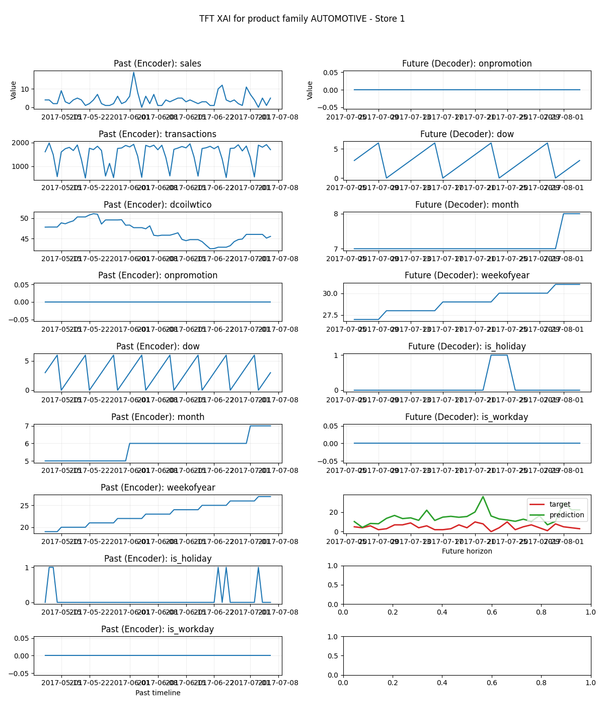
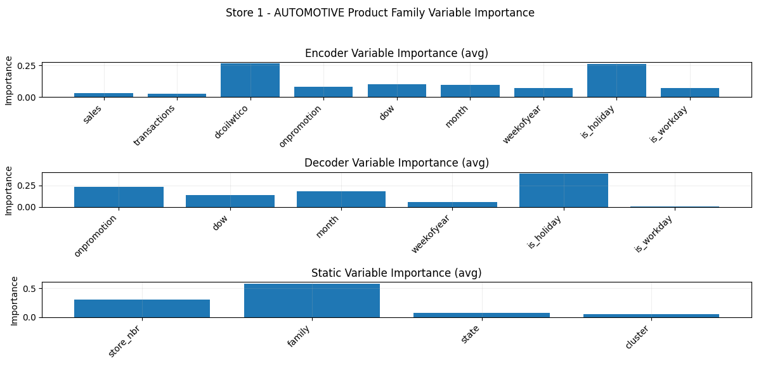
Model-Intrinsic Method
Attention and Variable Selection Weights

Slide 17
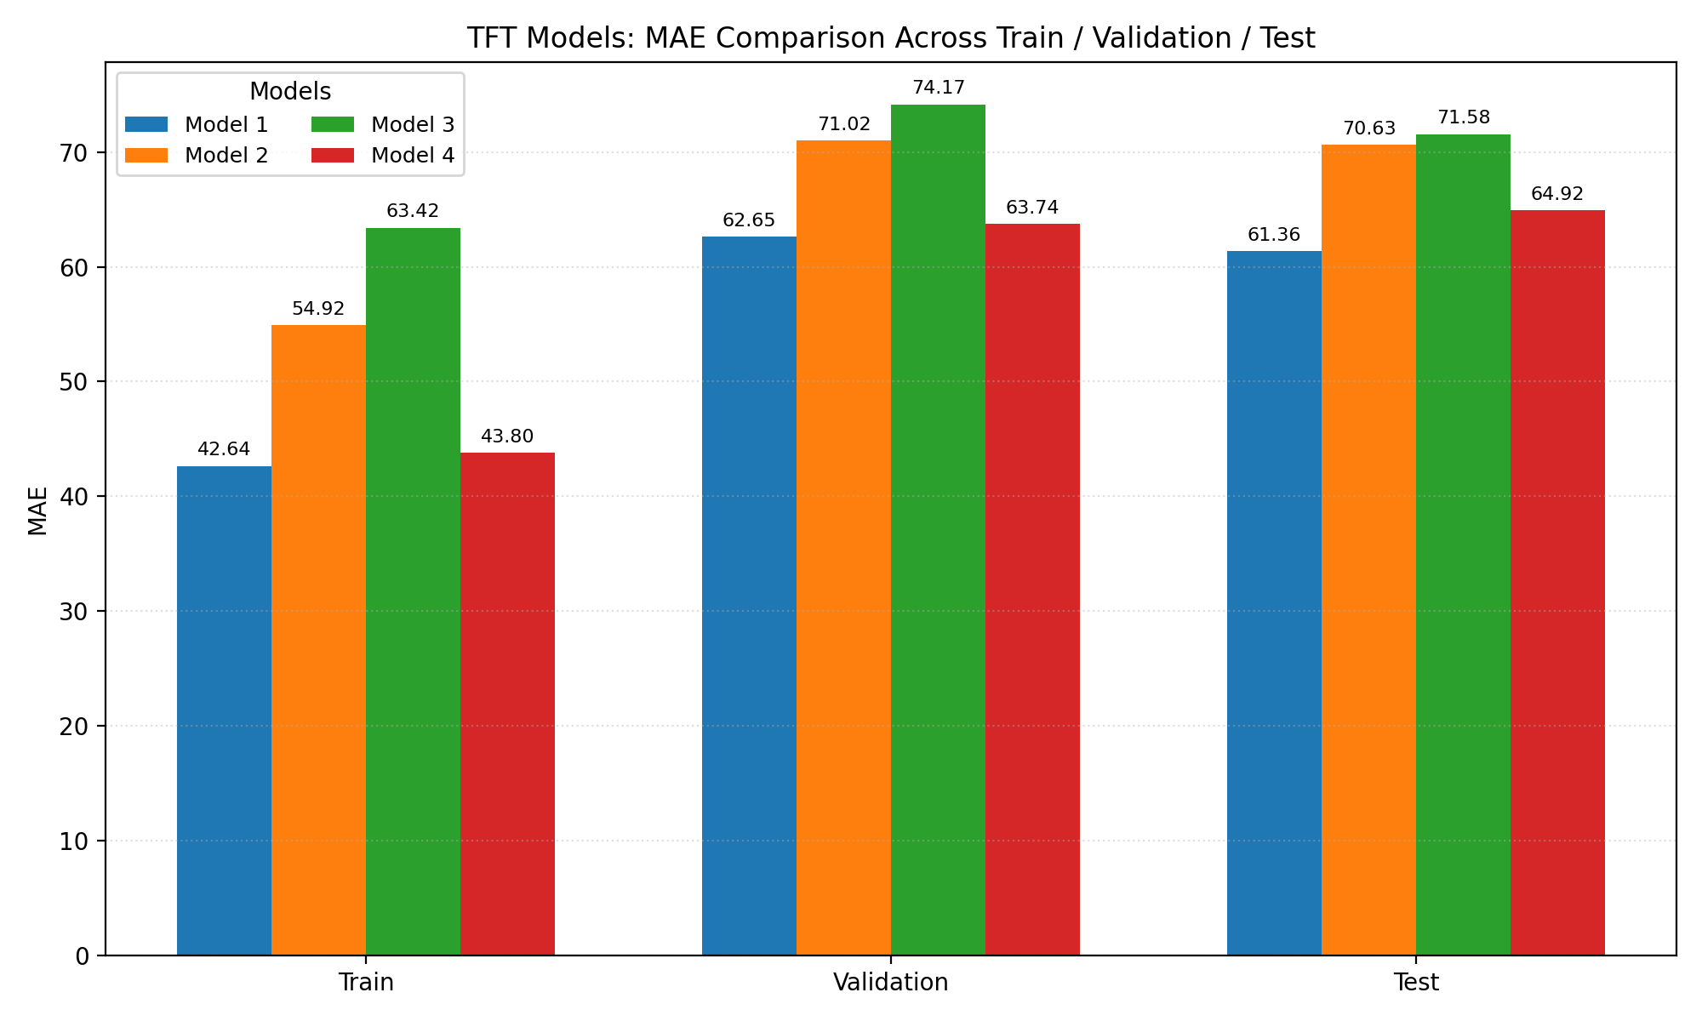
Parameters
--hidden-dim: 128 --d-model: 64 --heads: 4 --lstm-hidden: 64 --lstm-layers: 1 --dropout: 0.1
--hidden-dim: 64 --d-model: 32 --heads: 2 --lstm-hidden: 32 --lstm-layers: 1 --dropout: 0.1
--hidden-dim: 32 --d-model: 16 --heads: 2 --lstm-hidden: 16 --lstm-layers: 1 --dropout: 0.1
--hidden-dim: 256 --d-model: 128 --heads: 8 --lstm-hidden: 128 --lstm-layers: 1 --dropout: 0.3
Model Performance

Slide 18
2
Spatio-Temporal Graph Neural Network (STGNN)

Slide 19
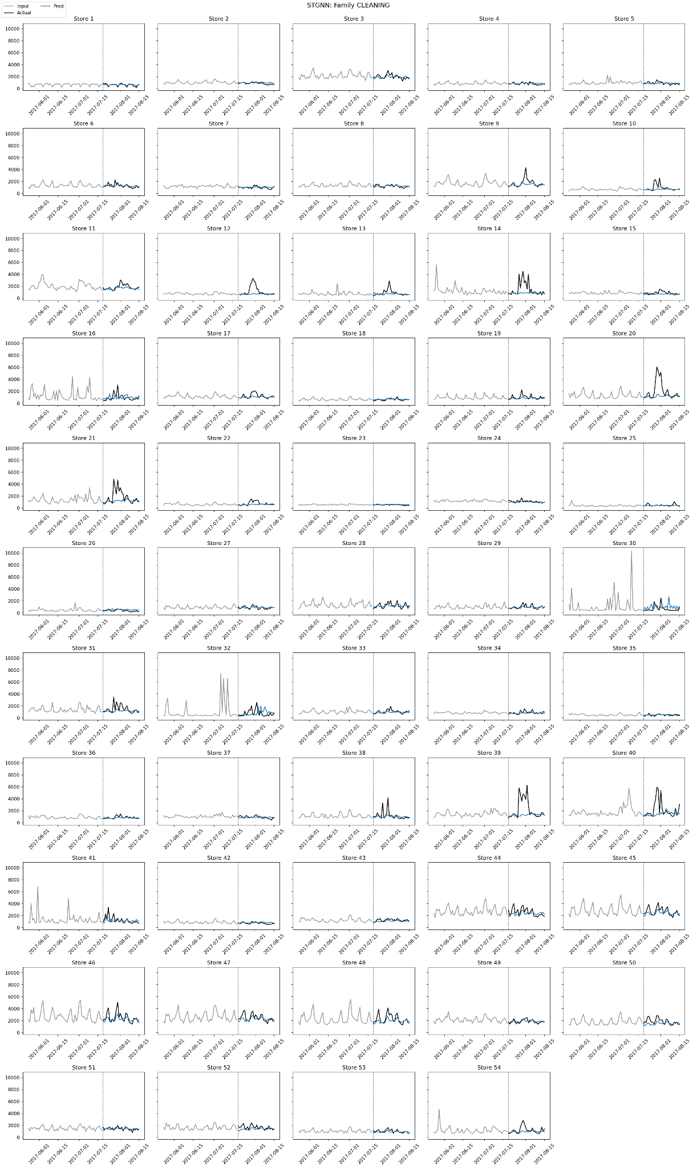
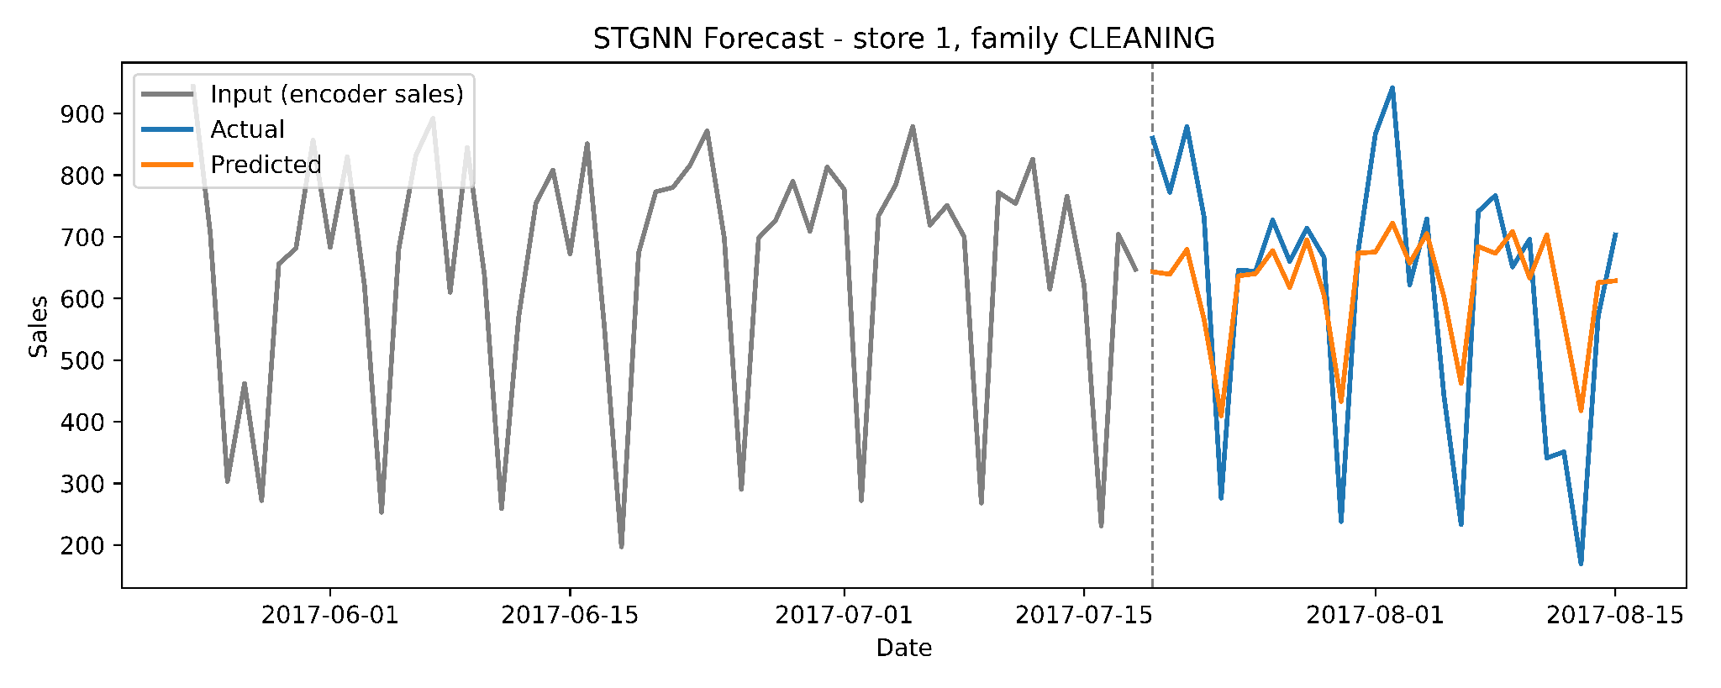
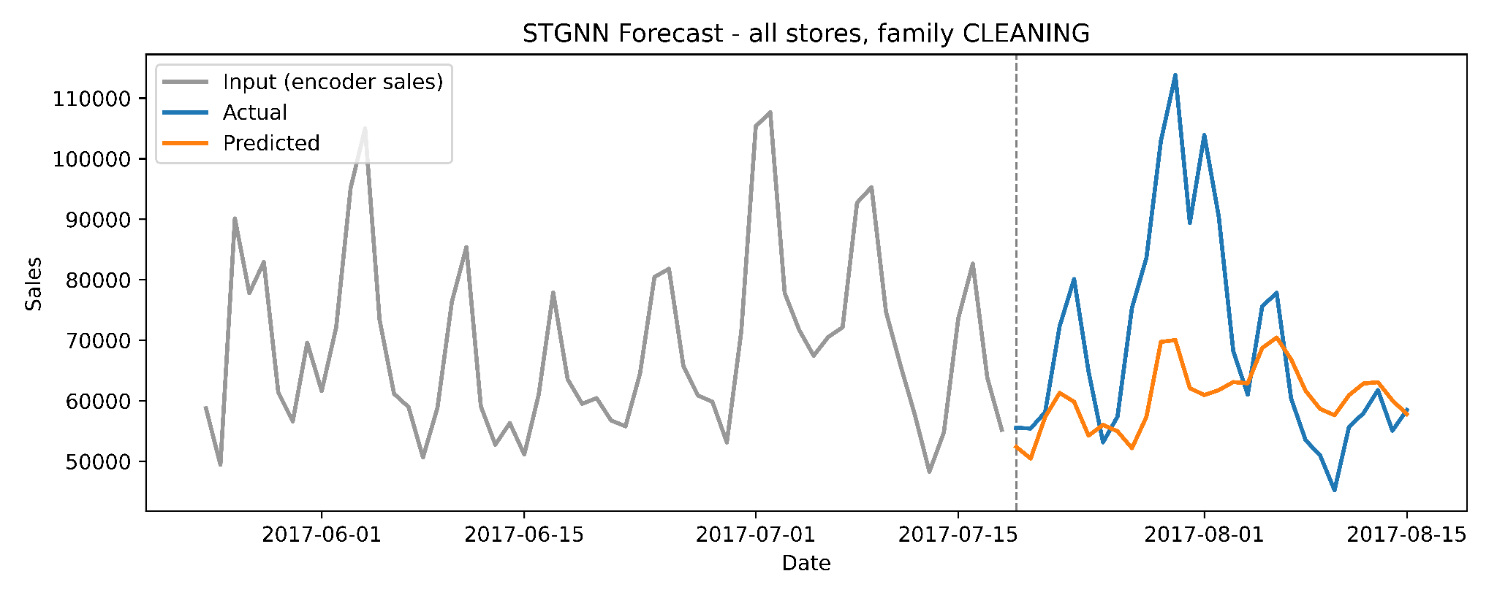
Spatio-Temporal Graph Neural Network

Slide 20
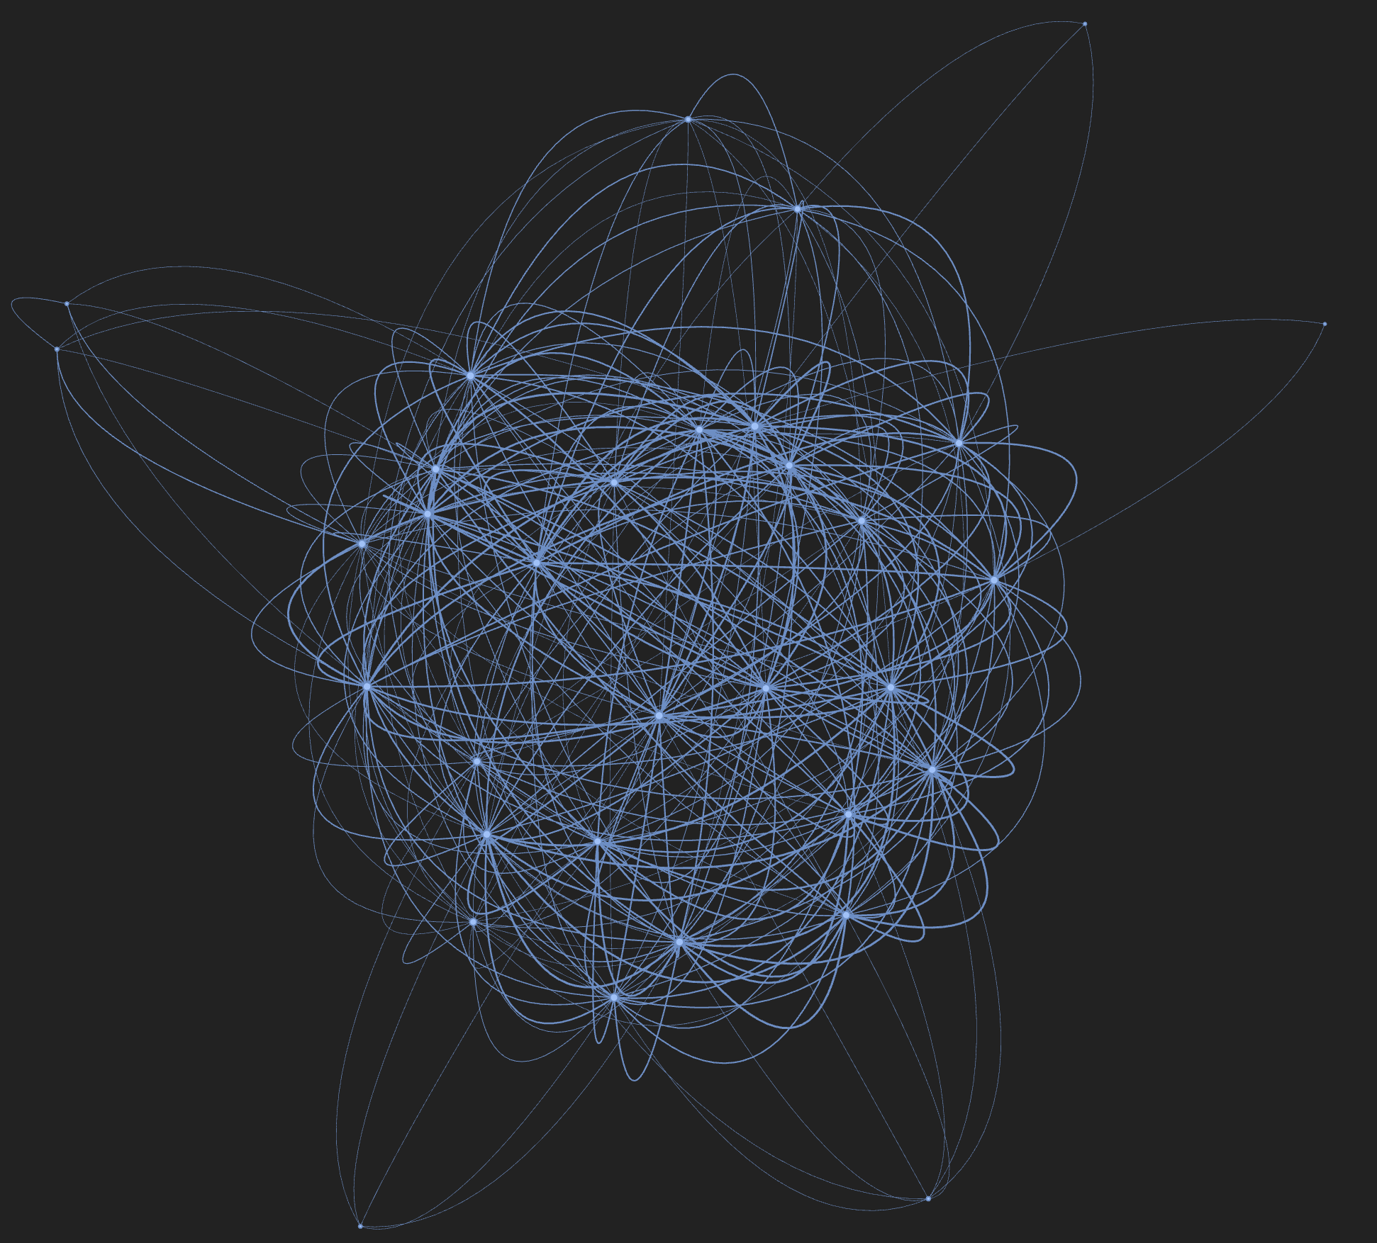
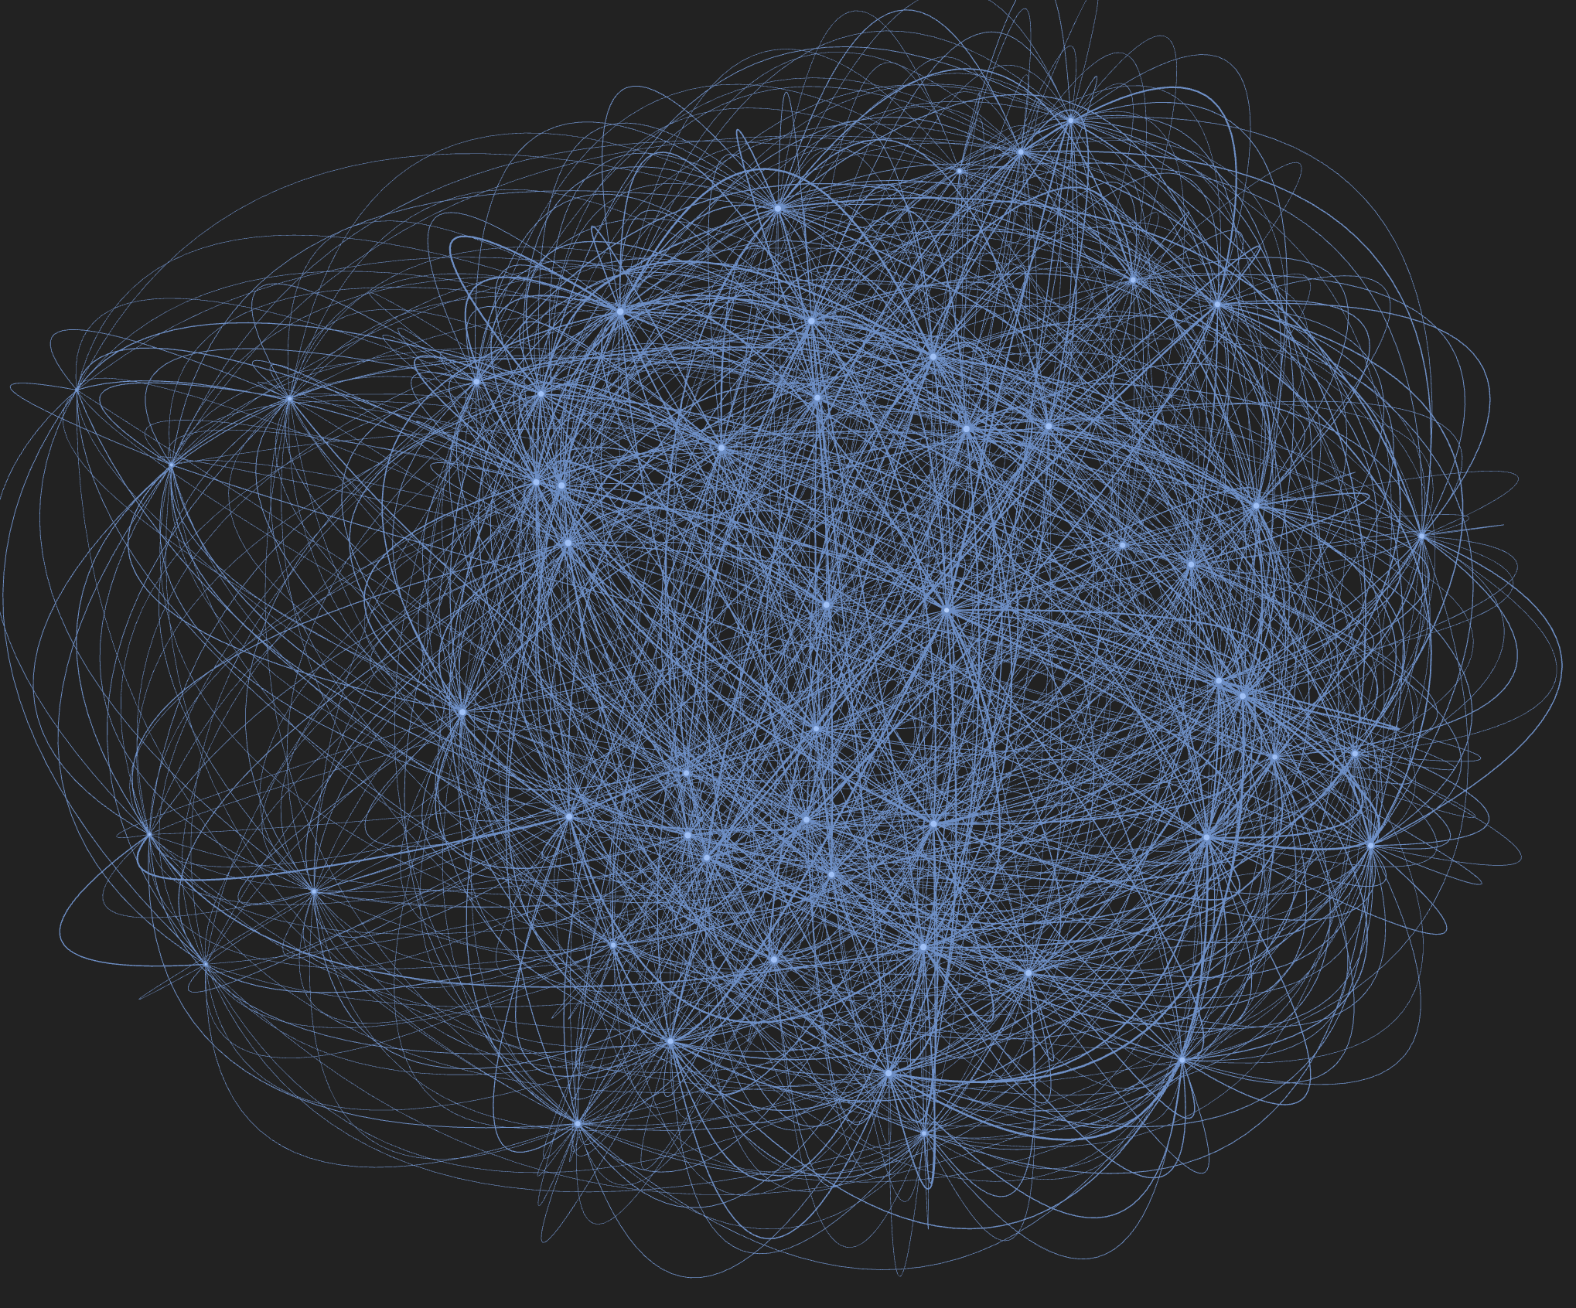
STGNN Data
T - Dates
N - Nodes (distinct pairs of store and family)
F - Feature columns
Figure 6.2.3.1 Store Graph illustration
Figure 6.2.4.1 Product-Family Graph

Slide 21
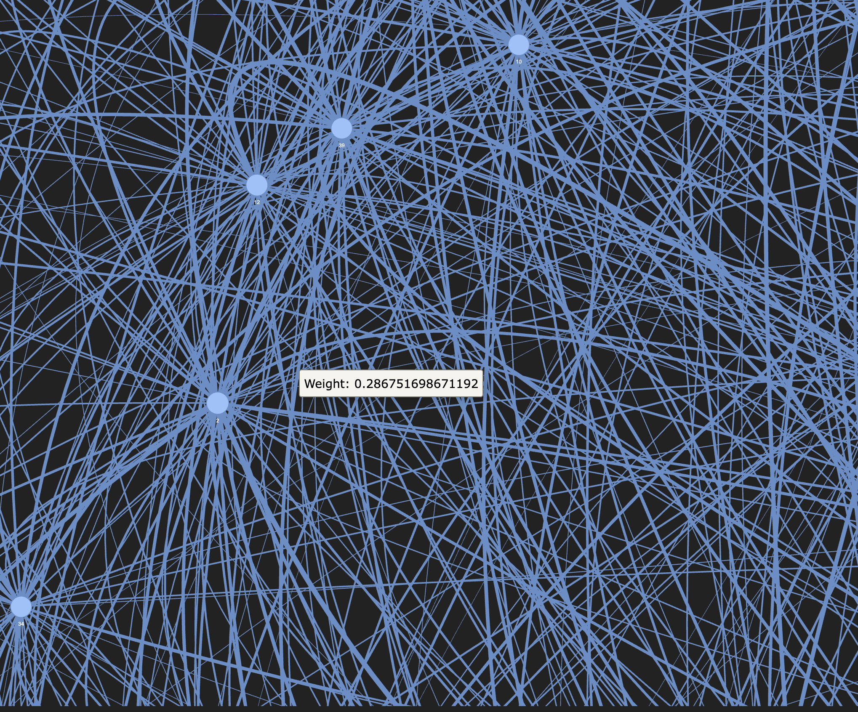
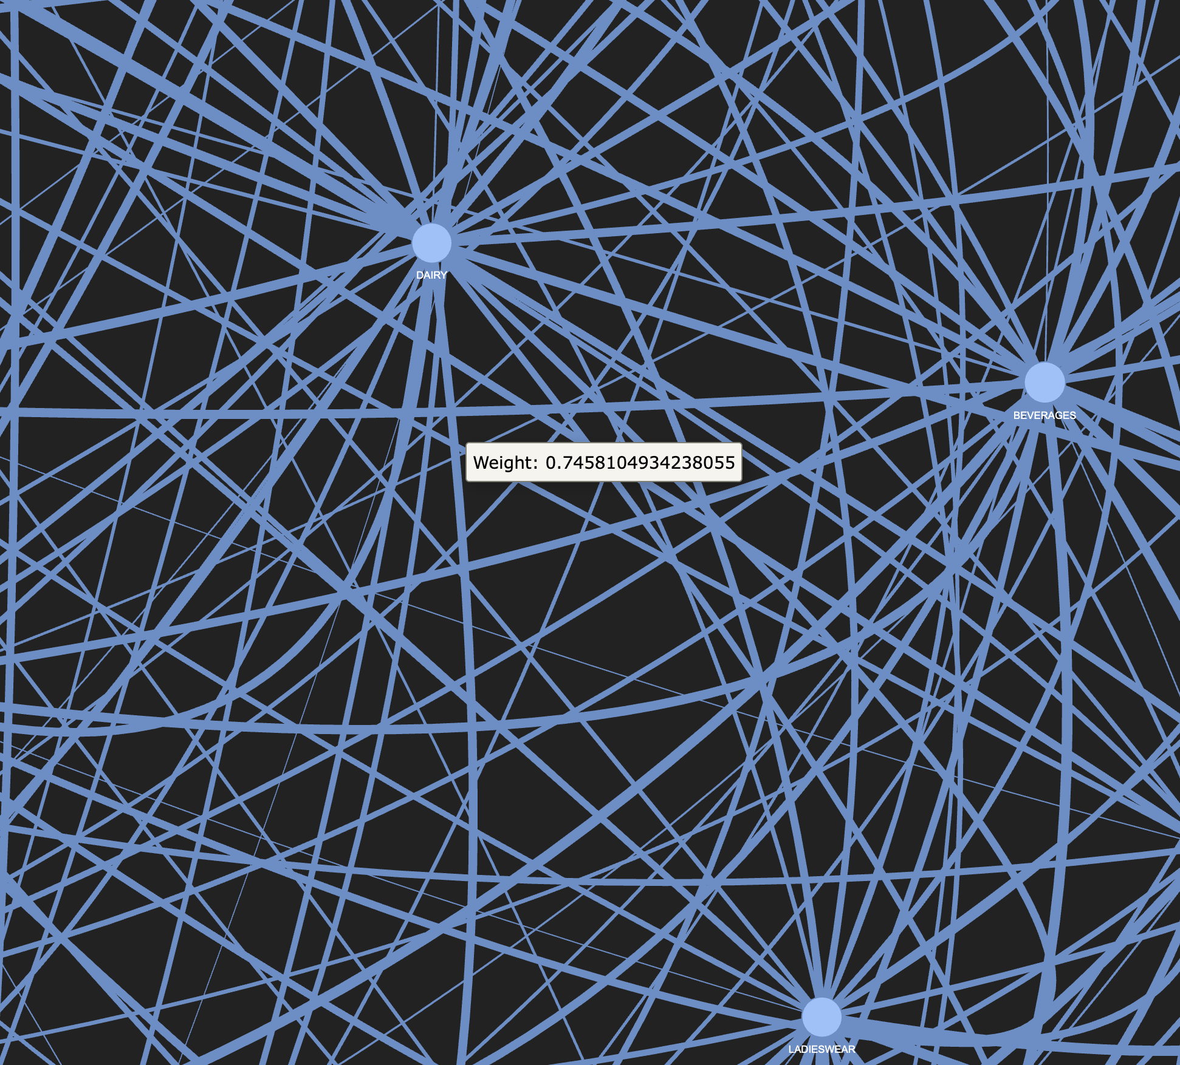
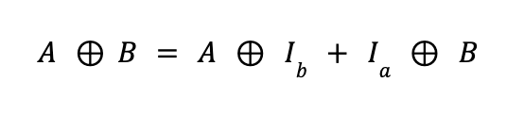
Store Graph
Family Graph
+0.5: if both stores belong to the same cluster
+0.3: if both stores are in the same state
+corr(transactions_a, transactions_b): Pearson correlation of the transaction time series
Pearson correlation coefficient is computed over a 60-day sales window for products (i) and (j)
If the correlation coefficient exceeds 0.3, an undirected edge is established between product (i) and (j), with the correlation value assigned as the weight
Kronecker-Sum

Slide 22
XAI

Slide 23
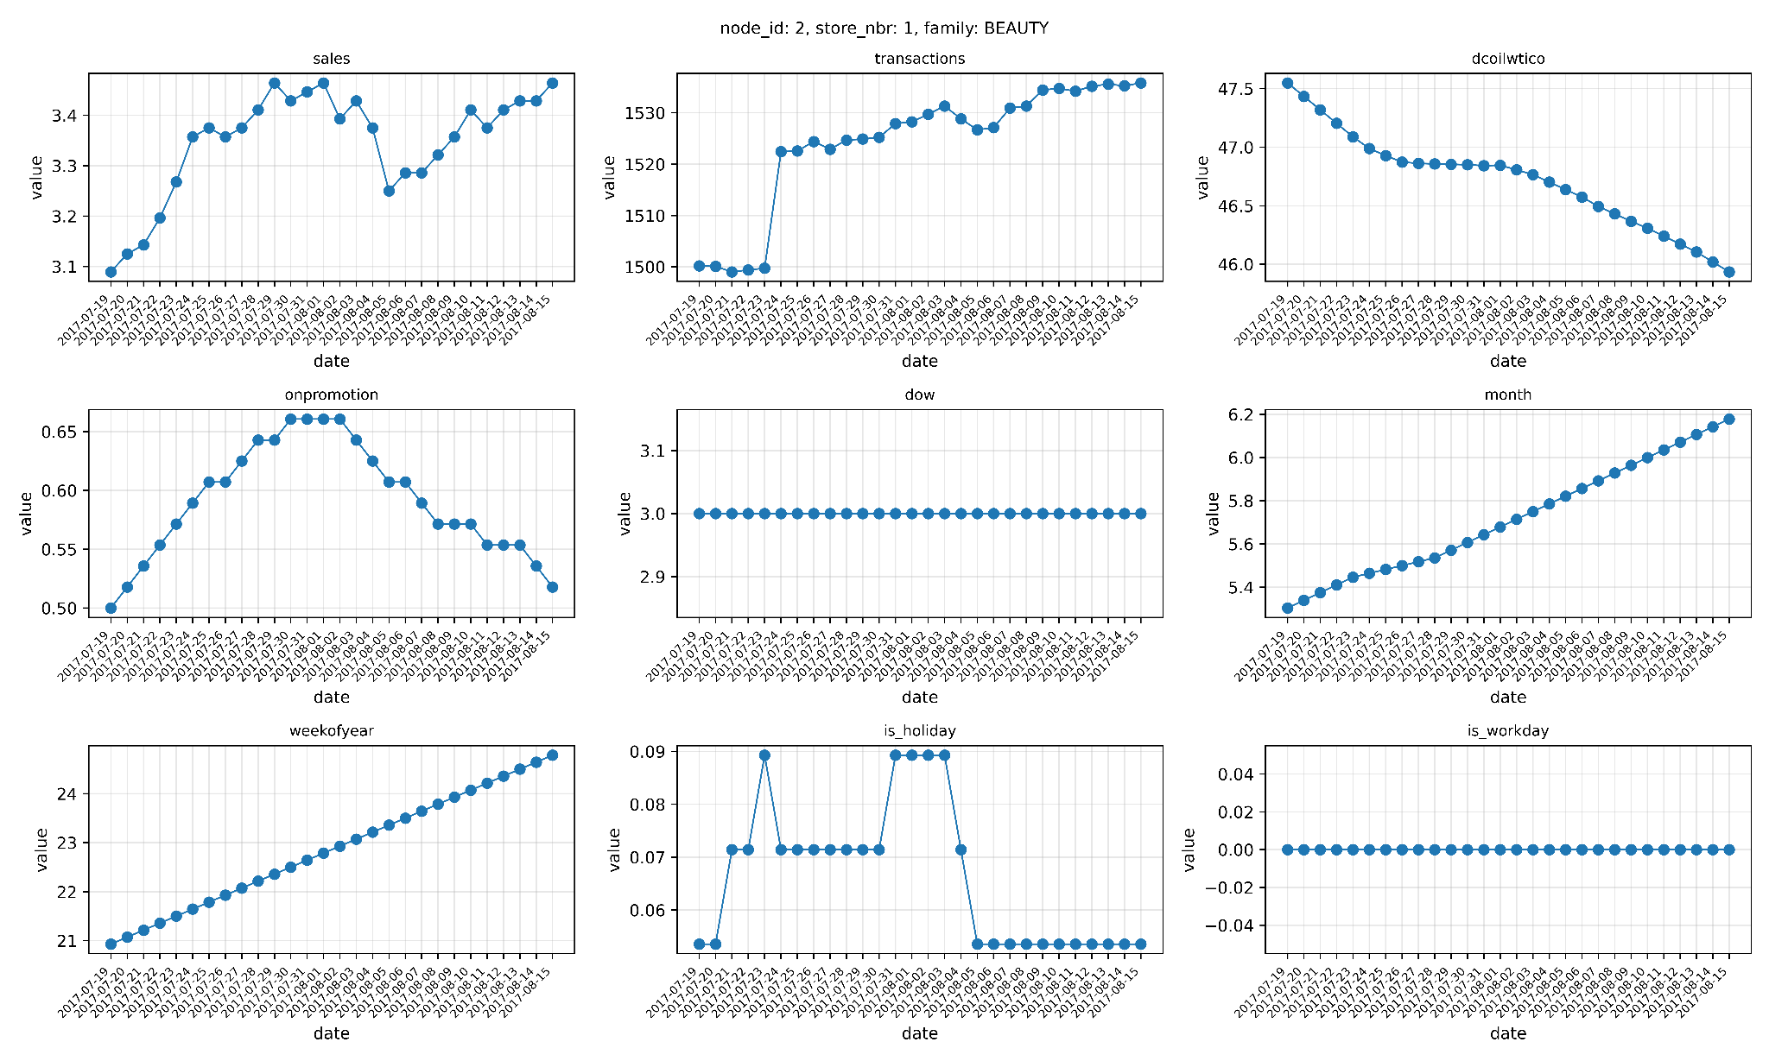
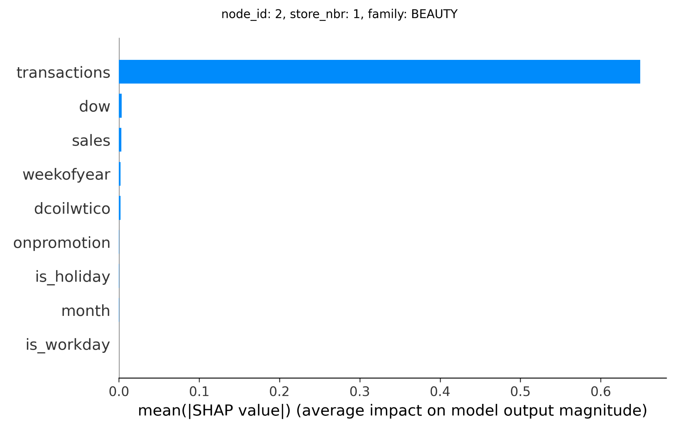
Feature-Level XAI: SHAP DeepExplainer
Feature | Mean absolute Shapley value
transactions | 0.6492
dow | 0.0033
sales | 0.0031
weekofyear | 0.0021
dcoilwtico | 0.0020
onpromotion | 0.0002
is_holiday | 0.0002
month | 0.0002
is_workday | 0.0

Slide 24
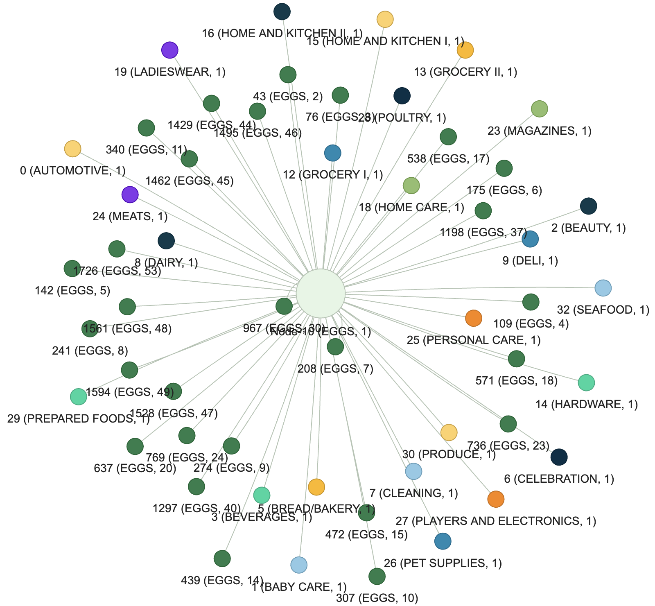
Structure-Level XAI
Custom Edge-Mask Explainer
Decision Influencing Neighbours

Slide 25
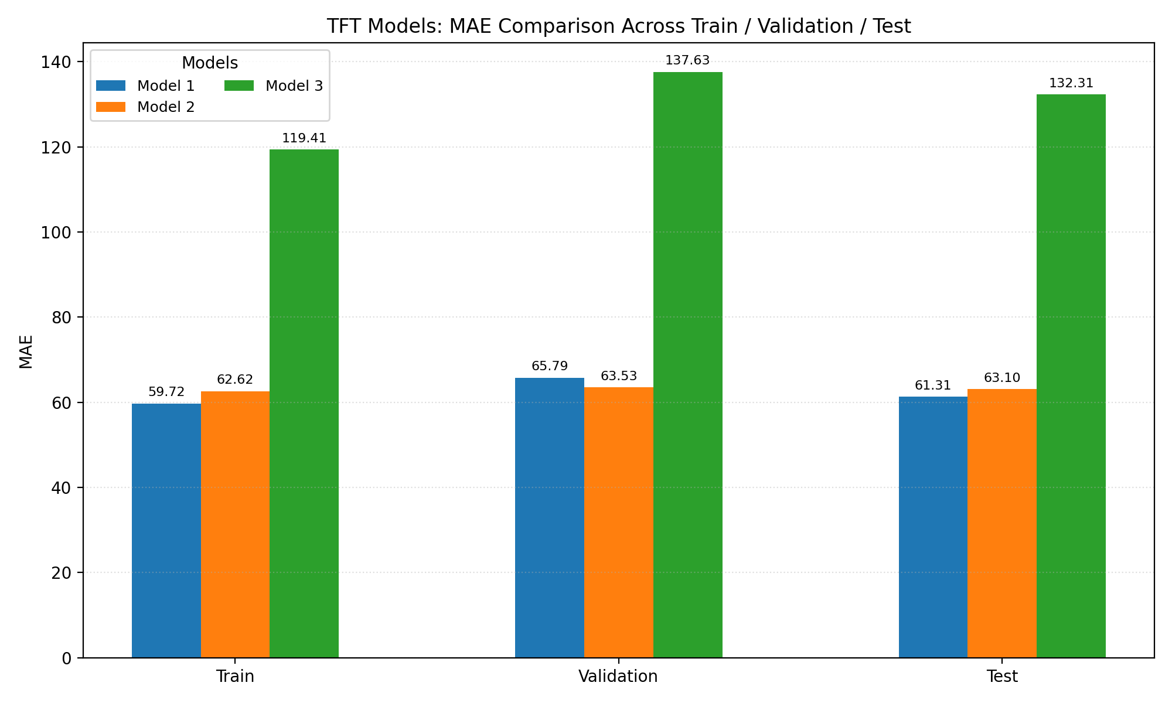
Performance
Parameters
--hidden: 64 --blocks: 3 --kernel: 3
--hidden: 32 --blocks: 3 --kernel: 3
--hidden: 16 --blocks: 1 --kernel: 1
Note from computational standpoint: configuring the model with hidden size of 128 or greater leads to GPU A100 memory allocation errors. Consequently, the model’s hidden size is restricted to the maximum feasible model capacity within the available computational resources.

Slide 26
3
Hybrid GNN-TFT

Slide 27
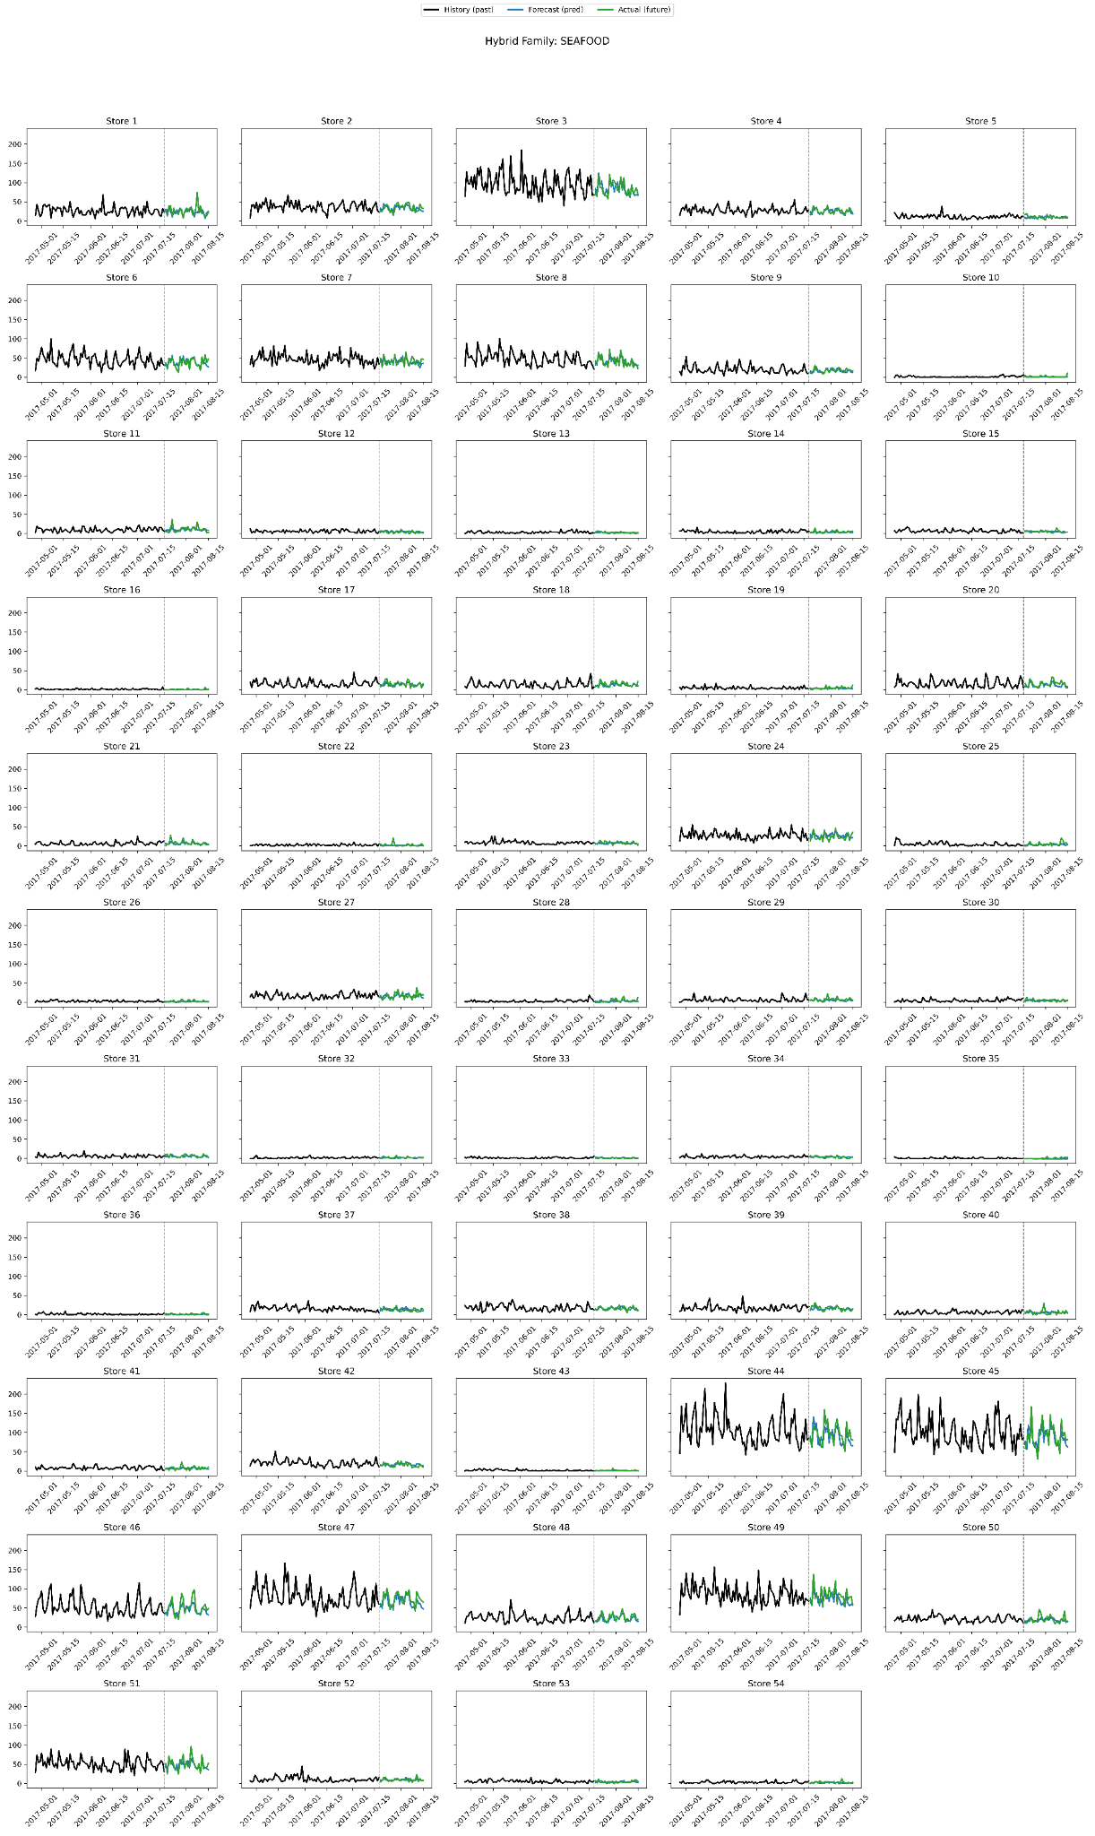
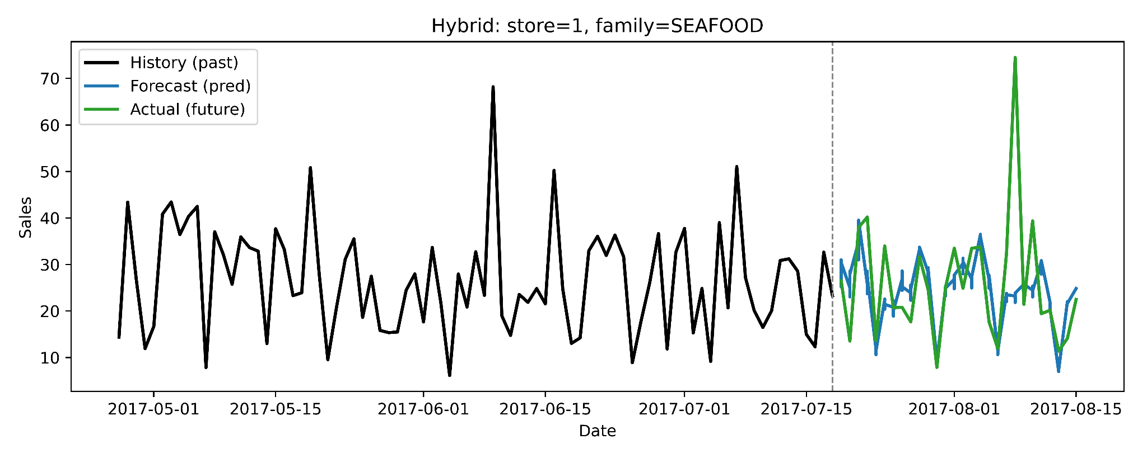
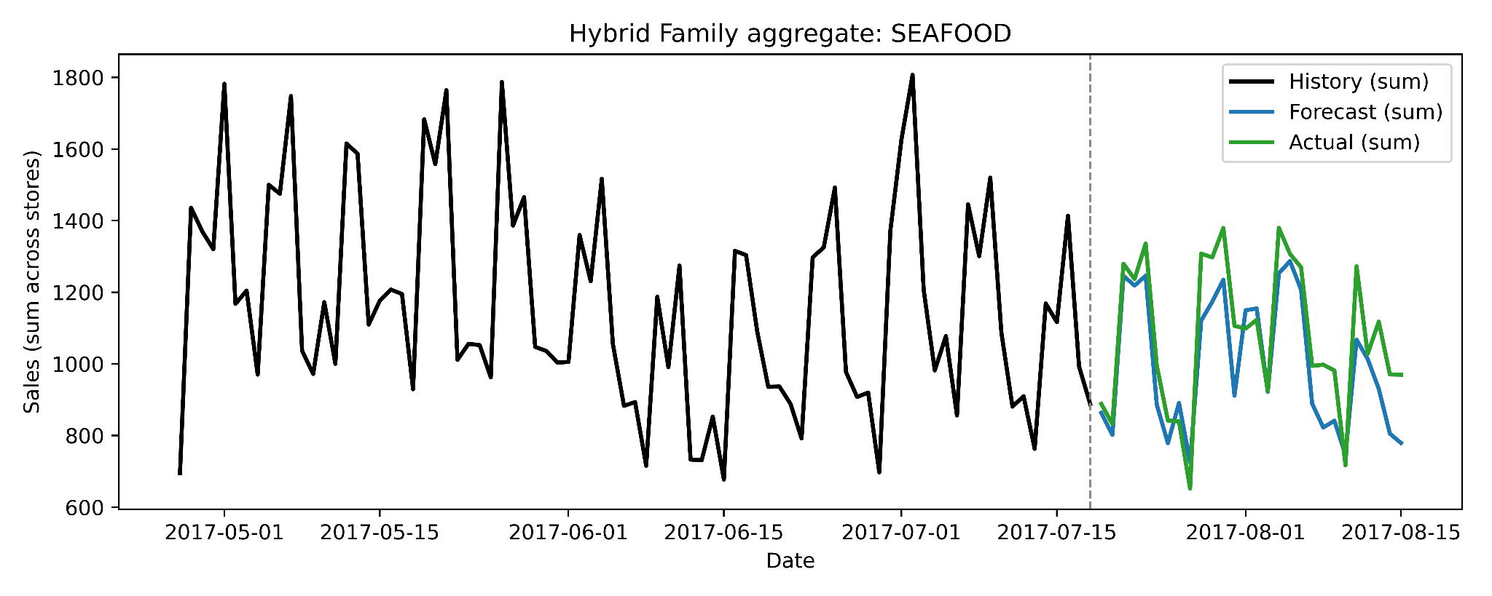
Hybrid Model

Slide 28
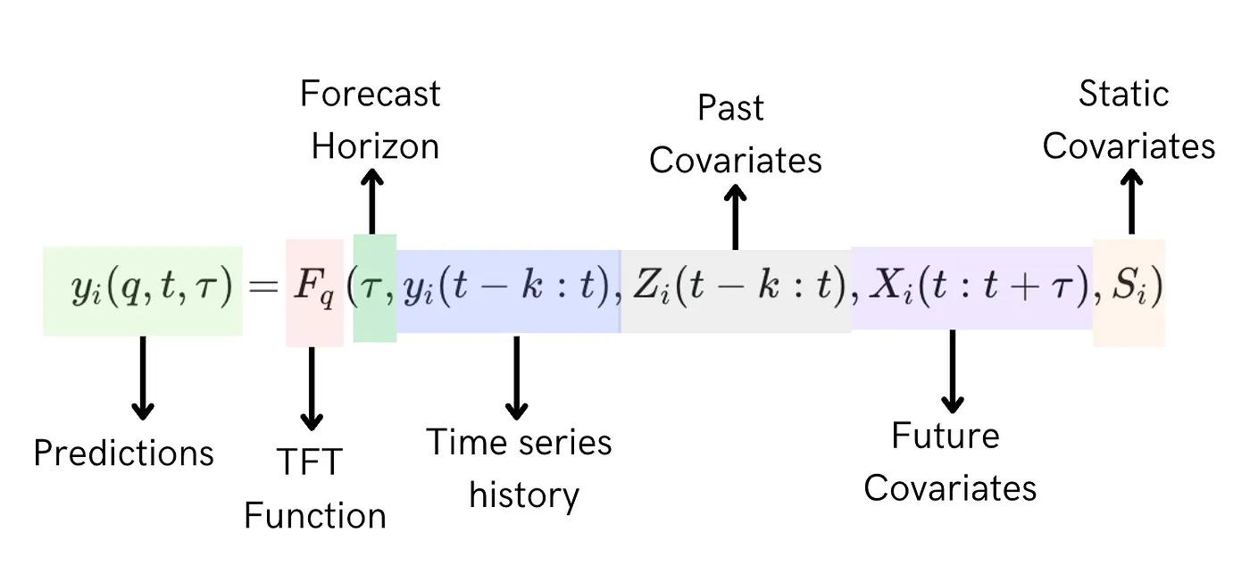
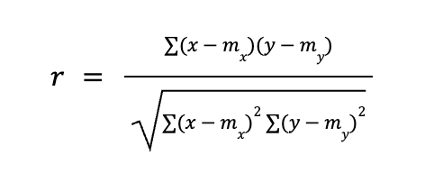
Hybrid Model Data
Exploits both relational and temporal patterns in the input data
Composed of two primary components: (1) Relational Encoder and (2) TFT
The RE employs a GNN to create node embeddings, thereby capturing the relational structure among product family and store number entities.
The node embeddings are concatenated with static input features, and then passed to the TFT block static covariate.
Node embeddings creation comprises the Pearson correlation coefficient computation

Slide 29
XAI

Slide 30
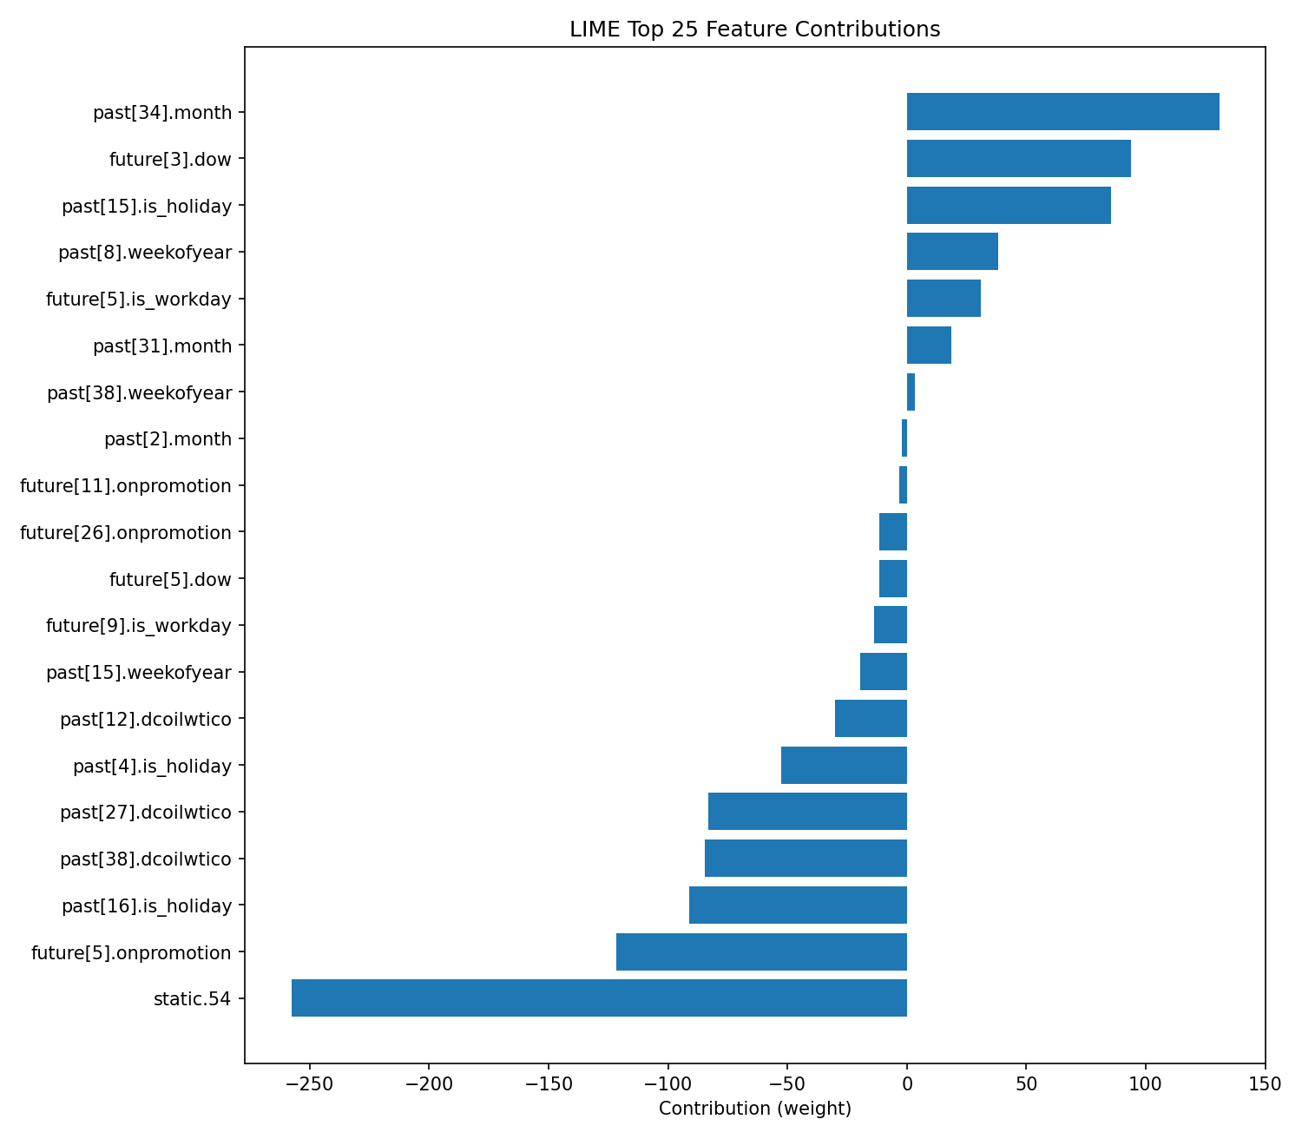
Hybrid XAI: LIME
Feature | Weight
past[34].month | 130.8142
future[3].dow | 93.7328
past[15].is_holiday | 85.4226
past[8].weekofyear | 38.0508
future[5].is_workday | 31.0180
past[31].month | 18.6158
past[38].weekofyear | 3.4062
past[2].month | -2.2726
future[11].onpromotion | -3.1617
future[26].onpromotion | -11.6736
future[5].dow | -11.7301
future[9].is_workday | -13.8870
past[15].weekofyear | -19.5332
past[12].dcoilwtico | -30.0725
past[4].is_holiday | -52.7784
past[27].dcoilwtico | -83.1999
past[38].dcoilwtico | -84.6973
past[16].is_holiday | -91.2767
future[5].onpromotion | -121.6794
static.54 | -257.7340

Slide 31
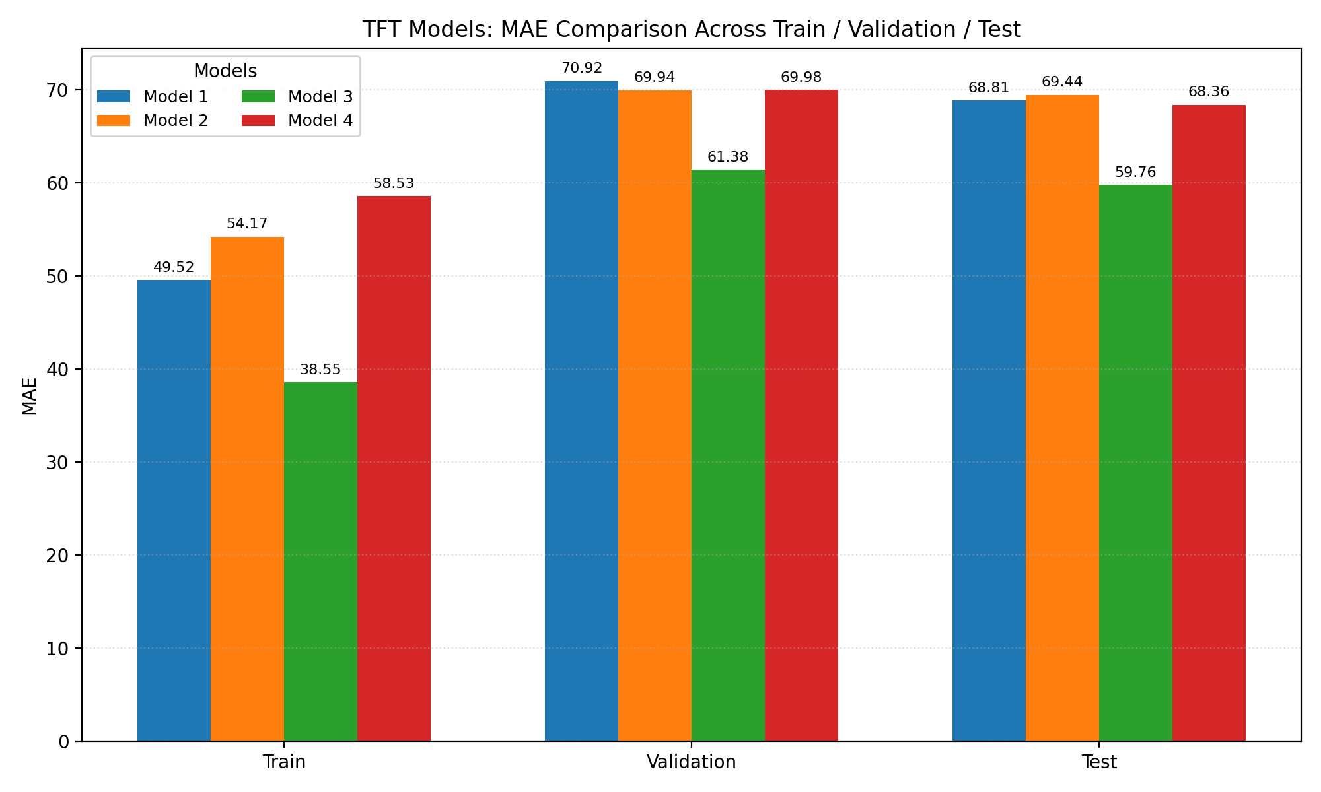
Hybrid Model Performance
Parameters
--hidden-dim: 128 --d-mode: 64 --heads: 4 --lstm-hidden: 64 --lstm-layers: 1 --gnn-hidden: 64 --gnn-embed: 32
--hidden-dim: 64 --d-mode: 32 --heads: 4 --lstm-hidden: 32 --lstm-layers: 1 --gnn-hidden: 32 --gnn-embed: 16
--hidden-dim: 256 --d-model: 128 --heads: 8 --lstm-hidden: 64 --lstm-layers: 3 --gnn-hidden: 128 --gnn-embed: 64
--hidden-dim: 32 --d-model: 16 --heads: 2 --lstm-hidden: 32 --lstm-layers: 1 --gnn-hidden: 16 --gnn-embed: 8

Slide 32
Model Performance Comparison
Key Points
TFT: Captures temporal sales patterns well, competitive MAE and WAPE.
GNN: Effective for structural and relational
features; close results to TFT.
Hybrid: Outperforms both, leveraging both temporal & relational aspects.
Model | Best Configuration | MAE | WAPE | SMAPE | Comments
TFT | hidden=128 emb=64 heads=4 LSTM=64×1 | 61.36 | 0.1287 | 0.5249 | Strong accuracy, stable learning
GNN | hidden=64 blocks=3 kernel=3 | 61.31 | 0.1286 | 0.5831 | Comparable to best TFT
Hybrid | hidden=256 emb=128 heads=8 LSTM=64×3 GNN=128 | 59.76 | 0.1253 | 0.5971 | Best overall (lower MAE, WAPE)

Slide 33
Summary
The highest performance - Hybrid model with 59.76 MAE
Difference - (1) 1,6 from TFT (2) 1,55 difference from GNN
The highly impacting features - future promotion, holiday, oil price, product family type, transactions, month, day-of-week, holidays
The least impacting features - future workday, static metadata like state, cluster, family, store number, and the concatenated static features (node embeddings and static attributes)
Although the performance of the hybrid model was high using concatenated static features, XAI analysis showed that static features had the greatest negative impact on the results
Experimental evaluation of key structural parameters demonstrates that tuning hidden layer dimensions, embedding sizes, attention heads, and network depth can markedly impact the predictive accuracy

Slide 34
Feasibility and Business Recommendations
Future Work
The modeling framework can be extended to finer levels of granularity (e.g., individual SKUs or regional clusters) if higher-resolution data is available, further enhancing operational precision.
Store owners and managers can use the forecasts to proactively adjust inventory, optimize promotional campaigns, and prepare staffing according to expected demand fluctuations in the next 28 days.
Accurate multi-horizon forecasts allow for better allocation of capital towards inventory purchases, minimizing both stockouts and excess.
Promotions and discounts can be strategically scheduled based on periods of forecasted lower demand, while high-demand periods can be leveraged for pricing optimization.
The use of model interpretation techniques provides actionable insights into which factors drive demand, supporting evidence-based decision making for both short-term and strategic interventions.
Demand Planning
Resource Allocation
Strategic Marketing
Explainability
Scalability

Slide 35
Research Objectives and Solutions
Research Objectives | How?
To evaluate and compare the forecasting accuracy of GNN, TFT, and hybrid GNN-TFT models. | - Developed each model using PyTorch. - Preprocessed and split the dataset. - Trained on Google Colab (A100, L4, T4 GPUs). - Performance measured by MAE, WAPE, and SMAPE.
To interpret model predictions by applying both model-specific and model-agnostic explainable AI (XAI) methods. | - TFT: Model-agnostic and intrinsic (built-in) XAI methods. - GNN: SHAP for feature-level, edge mask optimizer for neighbor-level explanations. - Hybrid: LIME for interpretability.
To find and implement architectural improvements, aiming to maximize predictive performance and operational value of models. | Trained models using various combinations of architectural parameters: • TFT: Hidden dim, model dim, heads, LSTM hidden, LSTM layers, dropout (4 combinations). • GNN: Hidden units, blocks, kernel sizes (3 combinations). • Hybrid: Hidden dim, model dim, heads, LSTM hidden, LSTM layers, GNN hidden, GNN embedding (4 combinations).

Slide 36
Thank you for your attention!
Q & A

